Slide 1
Generative model & Adversary
张煌昭
zhang_hz@pku.edu.cn

Slide 2
Overview
Generative model
Generative Adversarial Networks
Variational Auto Encoder
Diffusion Model
Adversarial learning
Adversarial attack
Adversarial training

Slide 3
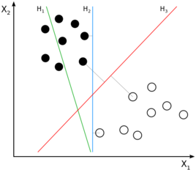
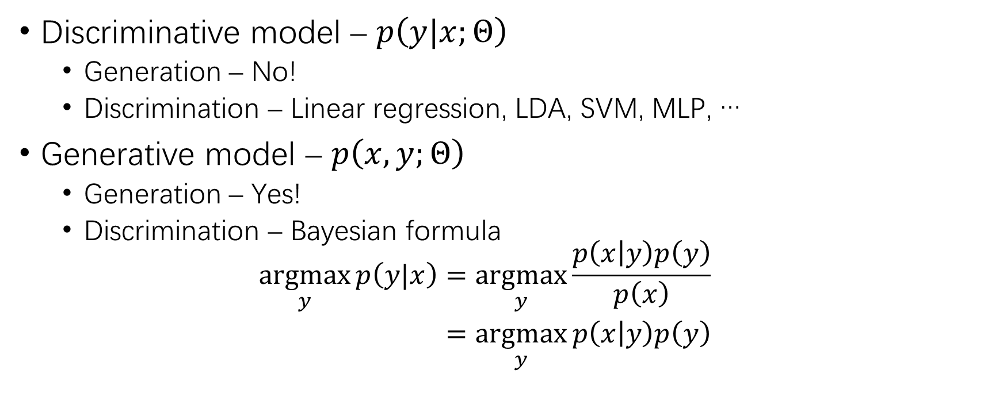
Discrimination & Generation
Discriminative model – $p\left(y|x;Θ\right)$
Generation – No!
Discrimination – Linear regression, LDA, SVM, MLP, …
Generative model – $p\left(x,y;Θ\right)$
Generation – Yes!
Discrimination – Bayesian formula
$$\begin{aligned}\underset{y}{argmax}{p\left(y|x\right)}&=\underset{y}{argmax}{\frac{p\left(x | y\right)p\left(y\right)}{p\left(x\right)}} \\ &=\underset{y}{argmax}{p\left(x | y\right)p\left(y\right)}\end{aligned}$$

Slide 4
Generative Adversarial Networks

Slide 5
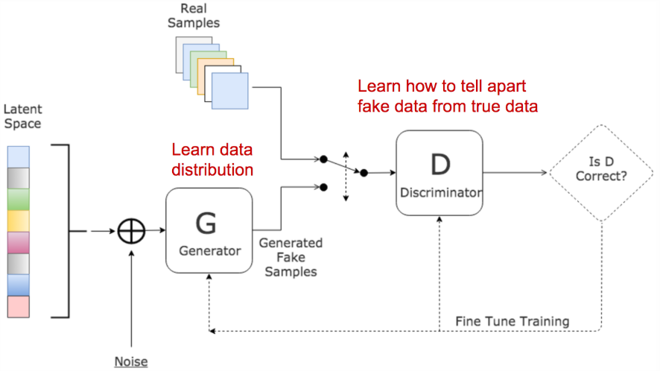
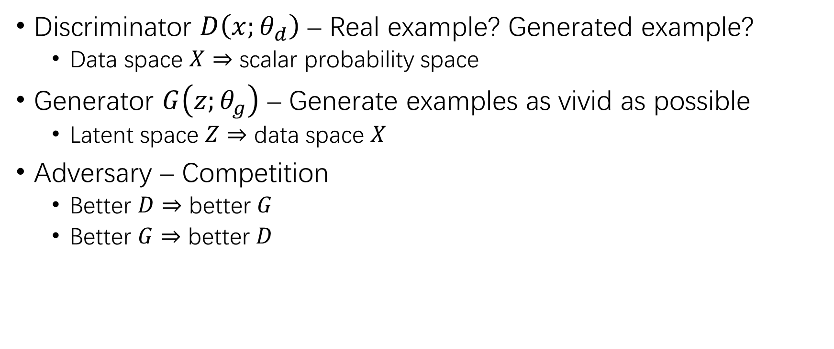
GAN
Discriminator $D\left(x;θ_{d}\right)$ – Real example? Generated example?
Data space $X$ $⇒$ scalar probability space
Generator $G\left(z;θ_{g}\right)$ – Generate examples as vivid as possible
Latent space $Z$ $⇒$ data space $X$
Adversary – Competition
Better $D$ $⇒$ better $G$
Better $G$ $⇒$ better $D$
Ian J. Goodfellow, Jean Puget-Abadie, Mehdi Mirza, Bing Xu, David Warde-Farley, Sherjil Ozair, Aaron C. Courville, Yoshua Bengio. Generative Adversarial Networks. CoRR abs/1406.2661 (2014).

Slide 6
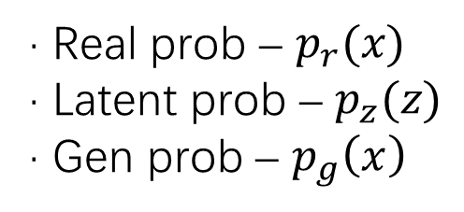
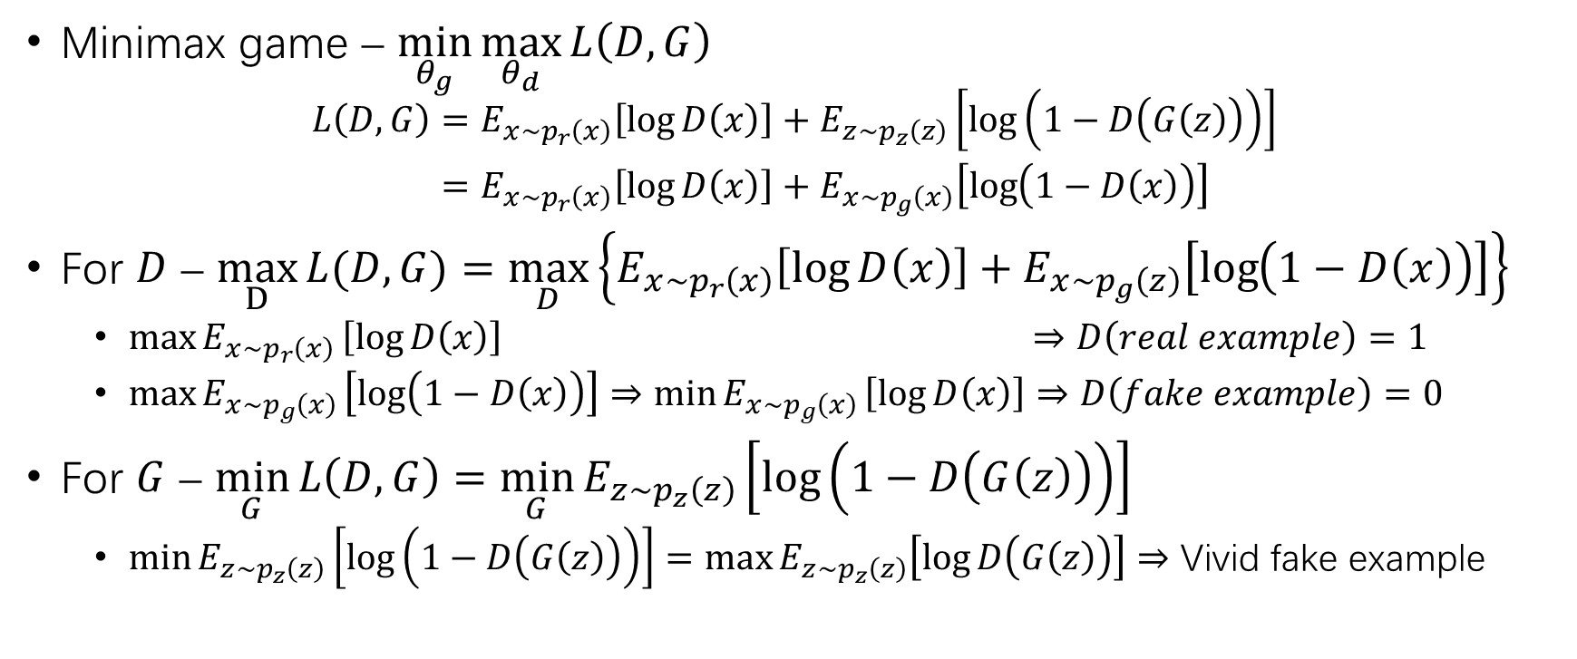
GAN (2)
· Real prob – $p_{r}(x)$
· Latent prob – $p_{z}(z)$
· Gen prob – $p_{g}\left(x\right)$
Minimax game – $\min_{θ_{g}}{\max_{θ_{d}}{L\left(D,G\right)}}$
$$\begin{aligned}L\left(D,G\right)&=E_{x\sim p_{r}\left(x\right)}\left[\log{D\left(x\right)}\right]+E_{z\sim p_{z}\left(z\right)}\left[\log\left(1−D\left(G\left(z\right)\right)\right)\right] \\ &=E_{x\sim p_{r}\left(x\right)}\left[\log{D\left(x\right)}\right]+E_{x\sim p_{g}\left(x\right)}\left[\log\left(1−D\left(x\right)\right)\right]\end{aligned}$$
For $D$ – $\max_{D}{L(D,G)}=\max_{D}\left\{E_{x\sim p_{r}\left(x\right)}\left[\log{D\left(x\right)}\right]+E_{x\sim p_{g}\left(z\right)}\left[\log\left(1−D\left(x\right)\right)\right]\right\}$
$\max{E_{x∼p_{r}\left(x\right)}}\left[\log{D\left(x\right)}\right]$ $⇒$ $D\left(real example\right)=1$
$\max{E_{x∼p_{g}\left(x\right)}}\left[\log\left(1−D\left(x\right)\right)\right]⇒\min{E_{x∼p_{g}\left(x\right)}}\left[\log{D\left(x\right)}\right]$ $⇒$ $D\left(fake example\right)=0$
For $G$ – $\min_{G}{L\left(D,G\right)=\min_{G}{E_{z\sim p_{z}\left(z\right)}\left[\log\left(1−D\left(G\left(z\right)\right)\right)\right]}}$
$\min{E_{z∼p_{z}\left(z\right)}\left[\log\left(1−D\left(G\left(z\right)\right)\right)\right]}=\max{E_{z∼p_{z}\left(z\right)}\left[\log{D\left(G\left(z\right)\right)}\right]}$ $⇒$ Vivid fake example

Slide 7
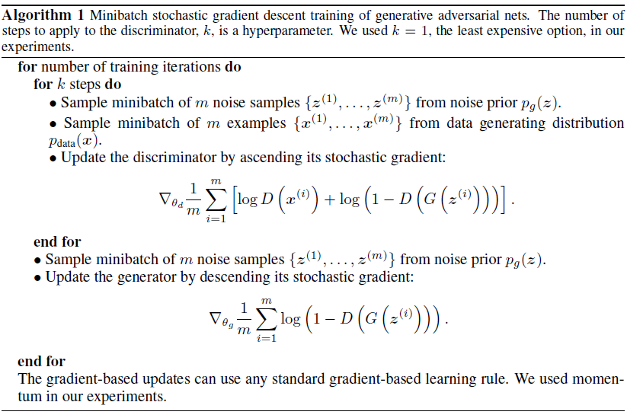

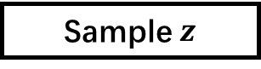
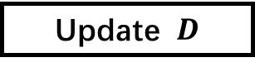
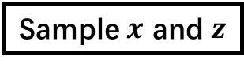

GAN (3)
Begin
Sample $x$ and $z$
Update $D$
$k$ iter?
No
Yes
Sample $z$
Update $G$
End?
No
Yes
End

Slide 8
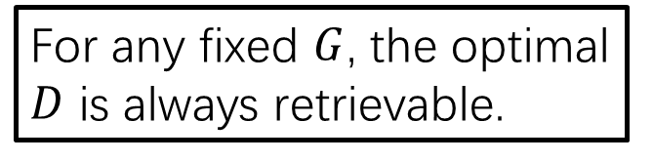
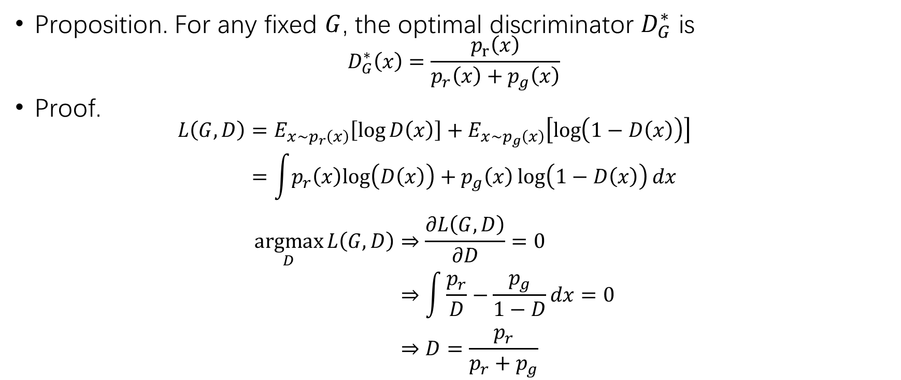
Global Optimality of GAN
Proposition. For any fixed $G$, the optimal discriminator $D_{G}^{∗}$ is
$$D_{G}^{∗}\left(x\right)=\frac{p_{r}\left(x\right)}{p_{r}\left(x\right)+p_{g}\left(x\right)}$$
Proof.
$$\begin{aligned}L\left(G,D\right)&=E_{x\sim p_{r}\left(x\right)}\left[\log{D\left(x\right)}\right]+E_{x\sim p_{g}\left(x\right)}\left[\log\left(1−D\left(x\right)\right)\right] \\ &=\int{p_{r}\left(x\right)log\left(D\left(x\right)\right)+p_{g}\left(x\right)\log\left(1−D\left(x\right)\right)}{dx}\end{aligned}$$
$$\begin{aligned}\underset{D}{argmax}{L\left(G,D\right)}&⇒\frac{∂L\left(G,D\right)}{∂D}=0 \\ &⇒\int{\frac{p_{r}}{D}−\frac{p_{g}}{1−D}}dx=0 \\ &⇒D=\frac{p_{r}}{p_{r}+p_{g}}\end{aligned}$$
For any fixed $G$, the optimal $D$ is always retrievable.

Slide 9
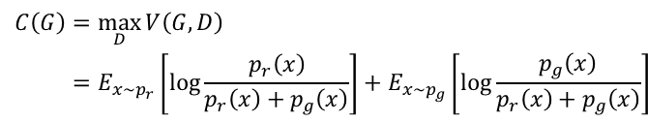
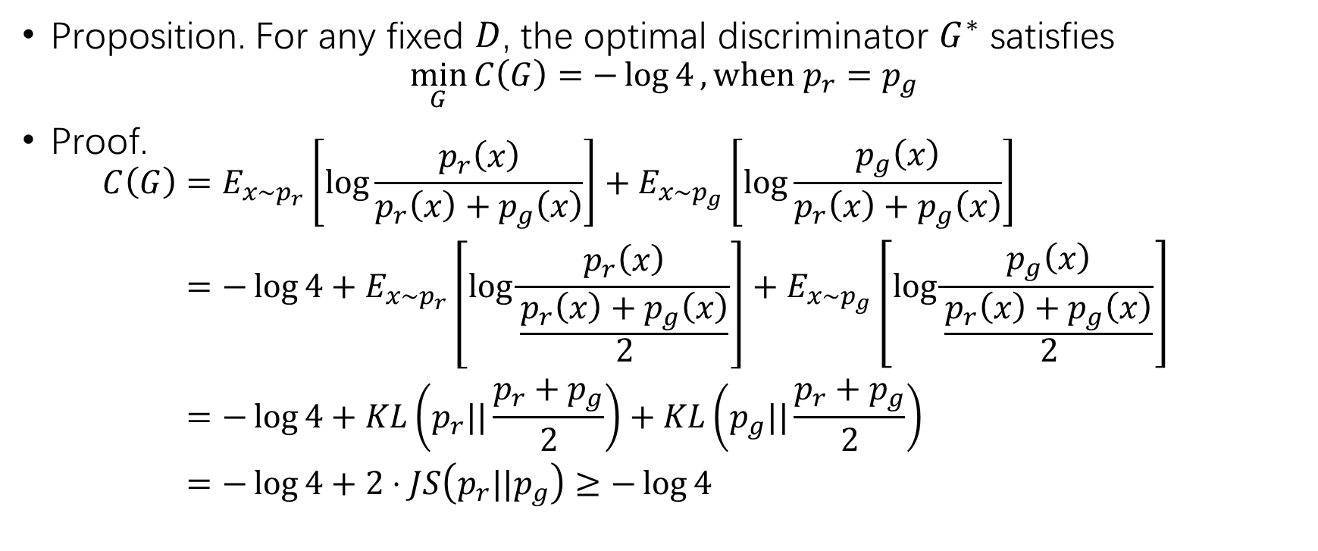
Global Optimality of GAN (2)
$$\begin{aligned}C\left(G\right)&=\max_{D}{V\left(G,D\right)} \\ &=E_{x\sim p_{r}}\left[\log{\frac{p_{r}\left(x\right)}{p_{r}\left(x\right)+p_{g}\left(x\right)}}\right]+E_{x\sim p_{g}}\left[\log{\frac{p_{g}\left(x\right)}{p_{r}\left(x\right)+p_{g}\left(x\right)}}\right]\end{aligned}$$
Proposition. For any fixed $D$, the optimal discriminator $G^{∗}$ satisfies
$$\min_{G}{C\left(G\right)}=−\log{4},when p_{r}=p_{g}$$
Proof.
$$\begin{aligned}C\left(G\right)&=E_{x\sim p_{r}}\left[\log{\frac{p_{r}\left(x\right)}{p_{r}\left(x\right)+p_{g}\left(x\right)}}\right]+E_{x\sim p_{g}}\left[\log{\frac{p_{g}\left(x\right)}{p_{r}\left(x\right)+p_{g}\left(x\right)}}\right] \\ &=−\log{4}+E_{x\sim p_{r}}\left[\log{\frac{p_{r}\left(x\right)}{\frac{p_{r}\left(x\right)+p_{g}\left(x\right)}{2}}}\right]+E_{x\sim p_{g}}\left[\log{\frac{p_{g}\left(x\right)}{\frac{p_{r}\left(x\right)+p_{g}\left(x\right)}{2}}}\right] \\ &=−\log{4}+KL\left(p_{r}||\frac{p_{r}+p_{g}}{2}\right)+KL\left(p_{g}||\frac{p_{r}+p_{g}}{2}\right) \\ &=−\log{4}+2⋅JS\left(p_{r}||p_{g}\right)≥−\log{4}\end{aligned}$$

Slide 10
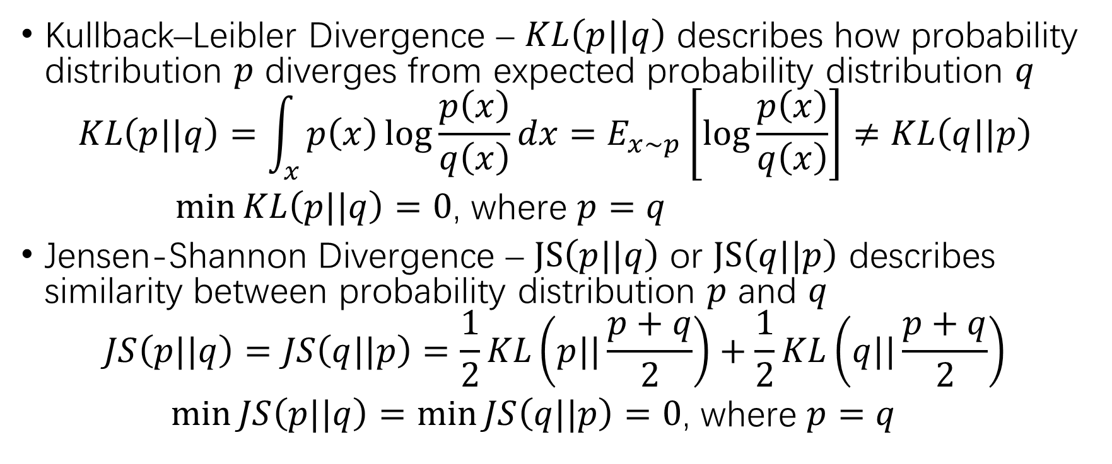
Interruption – KL & JS Divergence
Kullback–Leibler Divergence – $KL\left(p||q\right)$ describes how probability distribution $p$ diverges from expected probability distribution $q$
$$KL\left(p||q\right)=\int_{x}{p\left(x\right)\log{\frac{p\left(x\right)}{q\left(x\right)}}dx}=E_{x\sim p}\left[\log{\frac{p\left(x\right)}{q\left(x\right)}}\right]≠KL\left(q||p\right)$$
$\min{KL\left(p||q\right)=0}$, where $p=q$
Jensen-Shannon Divergence – $JS\left(p||q\right)$ or $JS\left(q||p\right)$ describes similarity between probability distribution $p$ and $q$
$$JS\left(p||q\right)=JS\left(q||p\right)=\frac{1}{2}KL\left(p||\frac{p+q}{2}\right)+\frac{1}{2}KL\left(q||\frac{p+q}{2}\right)$$
$\min{JS\left(p||q\right)=\min{JS\left(q||p\right)}=0}$, where $p=q$

Slide 11
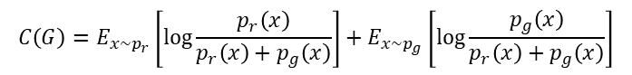
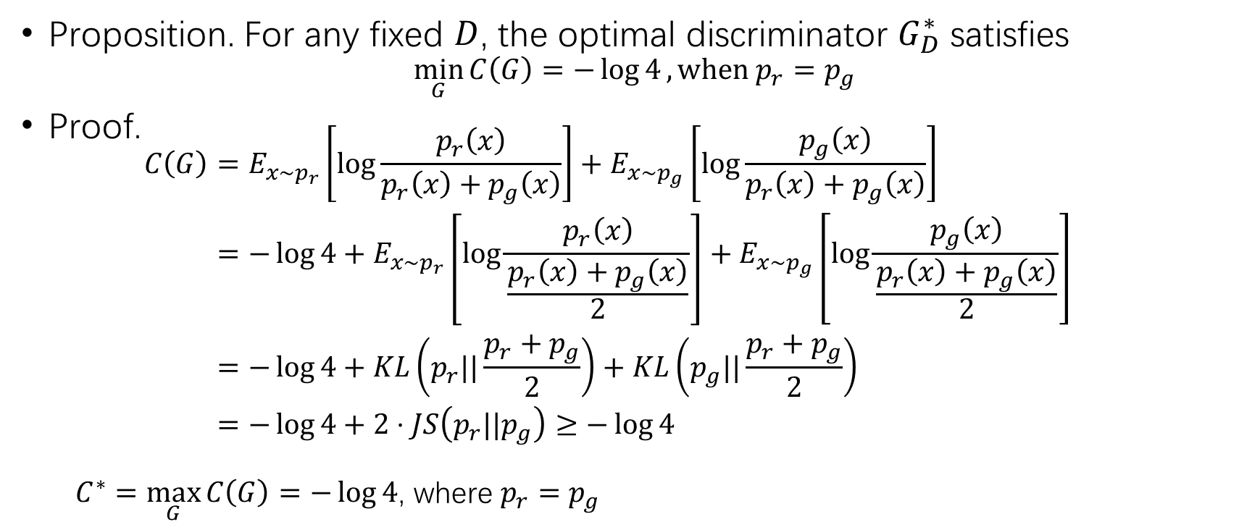
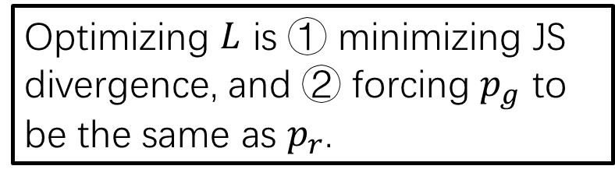
Global Optimality of GAN (2)
$$C\left(G\right)=E_{x\sim p_{r}}\left[\log{\frac{p_{r}\left(x\right)}{p_{r}\left(x\right)+p_{g}\left(x\right)}}\right]+E_{x\sim p_{g}}\left[\log{\frac{p_{g}\left(x\right)}{p_{r}\left(x\right)+p_{g}\left(x\right)}}\right]$$
Proposition. For any fixed $D$, the optimal discriminator $G_{D}^{∗}$ satisfies
$$\min_{G}{C\left(G\right)}=−\log{4},when p_{r}=p_{g}$$
Proof.
$$\begin{aligned}C\left(G\right)&=E_{x\sim p_{r}}\left[\log{\frac{p_{r}\left(x\right)}{p_{r}\left(x\right)+p_{g}\left(x\right)}}\right]+E_{x\sim p_{g}}\left[\log{\frac{p_{g}\left(x\right)}{p_{r}\left(x\right)+p_{g}\left(x\right)}}\right] \\ &=−\log{4}+E_{x\sim p_{r}}\left[\log{\frac{p_{r}\left(x\right)}{\frac{p_{r}\left(x\right)+p_{g}\left(x\right)}{2}}}\right]+E_{x\sim p_{g}}\left[\log{\frac{p_{g}\left(x\right)}{\frac{p_{r}\left(x\right)+p_{g}\left(x\right)}{2}}}\right] \\ &=−\log{4}+KL\left(p_{r}||\frac{p_{r}+p_{g}}{2}\right)+KL\left(p_{g}||\frac{p_{r}+p_{g}}{2}\right) \\ &=−\log{4}+2⋅JS\left(p_{r}||p_{g}\right)≥−\log{4}\end{aligned}$$
$C^{∗}=\max_{G}{C\left(G\right)}=−\log{4}$, where $p_{r}=p_{g}$
Optimizing $L$ is ① minimizing JS divergence, and ② forcing $p_{g}$ to be the same as $p_{r}$.

Slide 12
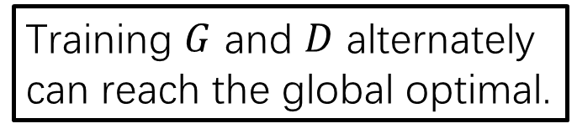
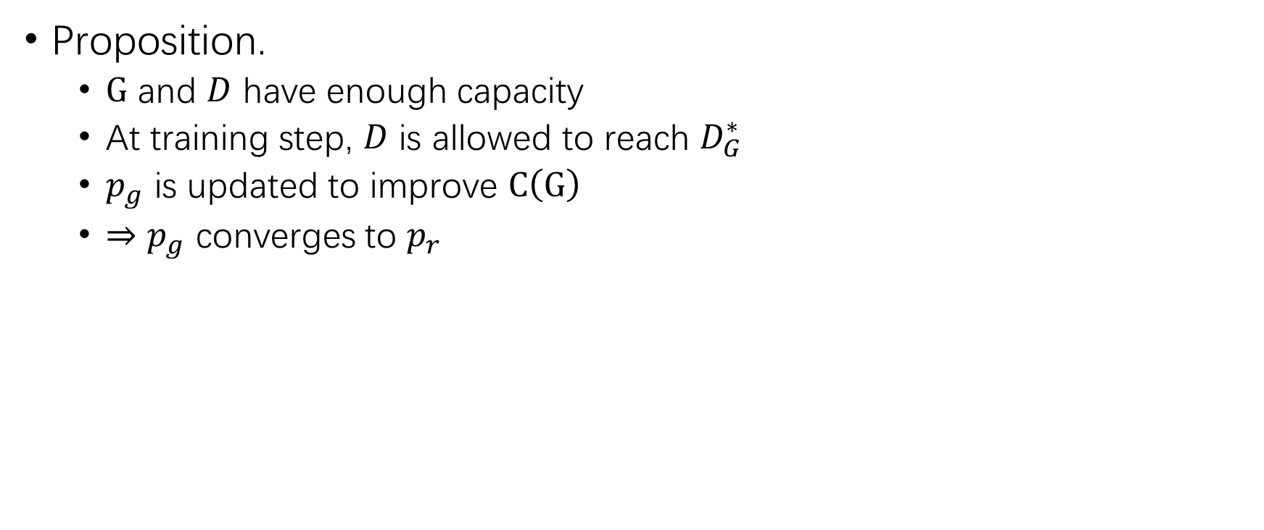
Global Optimality of GAN (3)
Begin
Sample $x$ and $z$
Proposition.
$G$ and $D$ have enough capacity
At training step, $D$ is allowed to reach $D_{G}^{∗}$
$p_{g}$ is updated to improve $C\left(G\right)$
$⇒$ $p_{g}$ converges to $p_{r}$
Update $D$
$k$ iter?
No
Yes
Sample $z$
Update $G$
End?
Training $G$ and $D$ alternately can reach the global optimal.
No
Yes
End

Slide 13
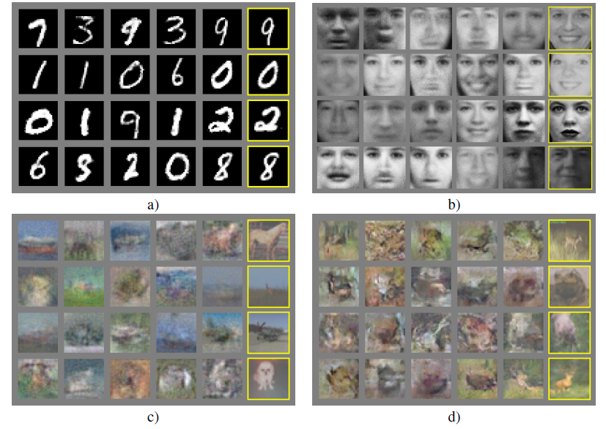
Examples Generated by GAN

Slide 14
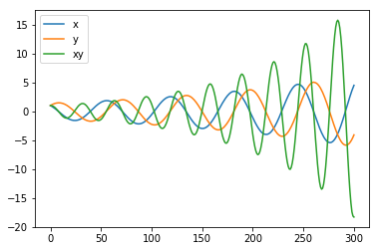
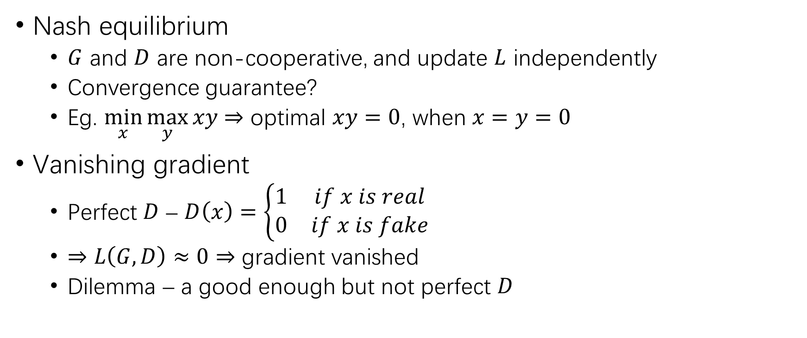
Challenges in GAN
Nash equilibrium
$G$ and $D$ are non-cooperative, and update $L$ independently
Convergence guarantee?
Eg. $\min_{x}{\max_{y}{xy}}$ $⇒$ optimal $xy=0$, when $x=y=0$
Vanishing gradient
Perfect $D$ – $D\left(x\right)=\left\{\begin{matrix}1 & if x is real \\ 0 & if x is fake\end{matrix}\right.$
$⇒$ $L\left(G,D\right)≈0$ $⇒$ gradient vanished
Dilemma – a good enough but not perfect $D$

Slide 15
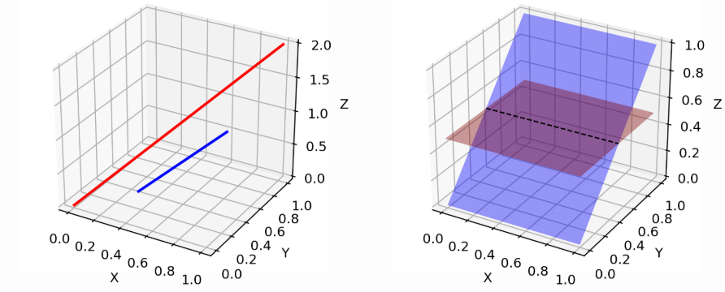
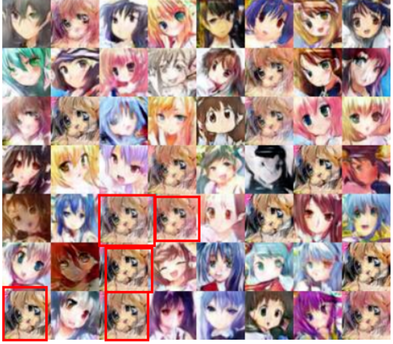
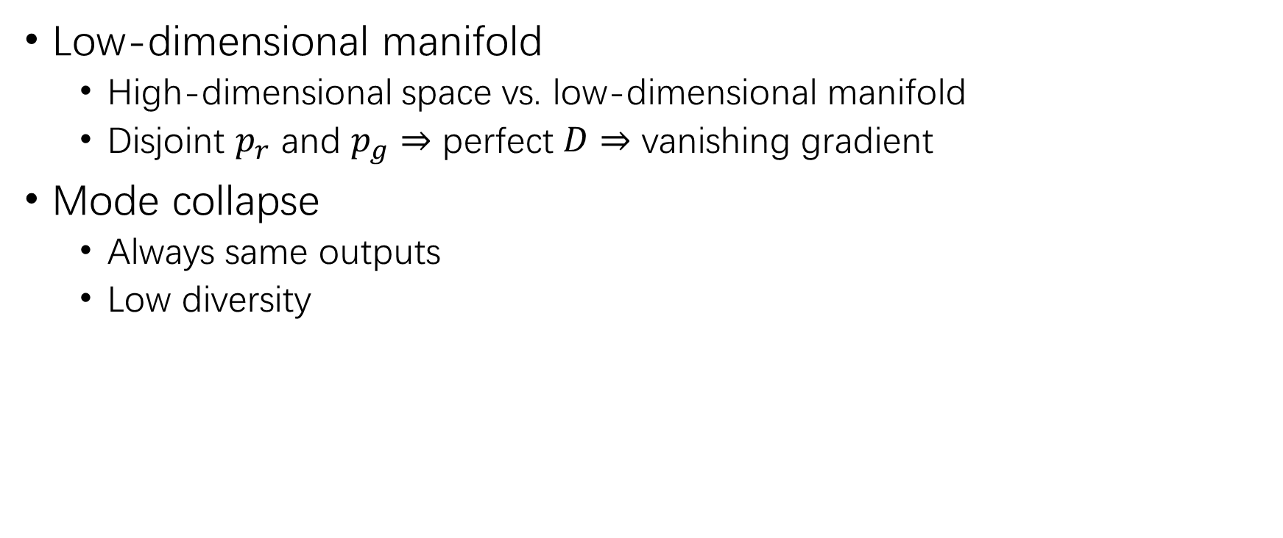
Challenges in GAN (2)
Low-dimensional manifold
High-dimensional space vs. low-dimensional manifold
Disjoint $p_{r}$ and $p_{g}$ $⇒$ perfect $D$ $⇒$ vanishing gradient
Mode collapse
Always same outputs
Low diversity

Slide 16
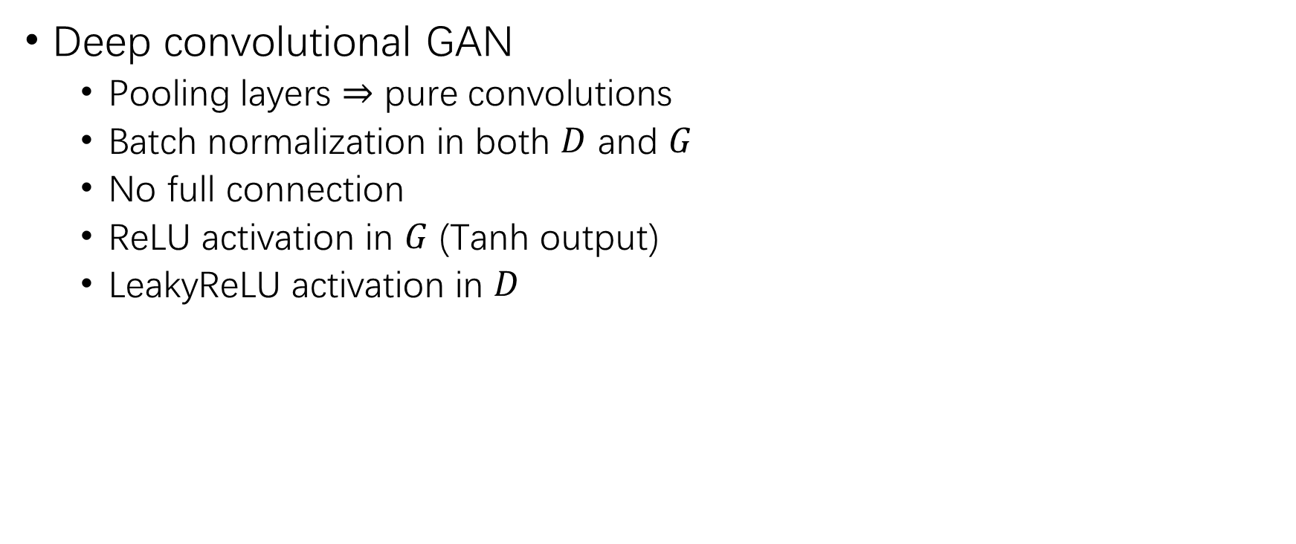
DCGAN
Deep convolutional GAN
Pooling layers $⇒$ pure convolutions
Batch normalization in both $D$ and $G$
No full connection
ReLU activation in $G$ (Tanh output)
LeakyReLU activation in $D$
Alec Radford, Luke Metz, Soumith Chintala. Unsupervised Representation Learning with Deep Convolutional Generative Adversarial Networks. ICLR (Poster) 2016.

Slide 17
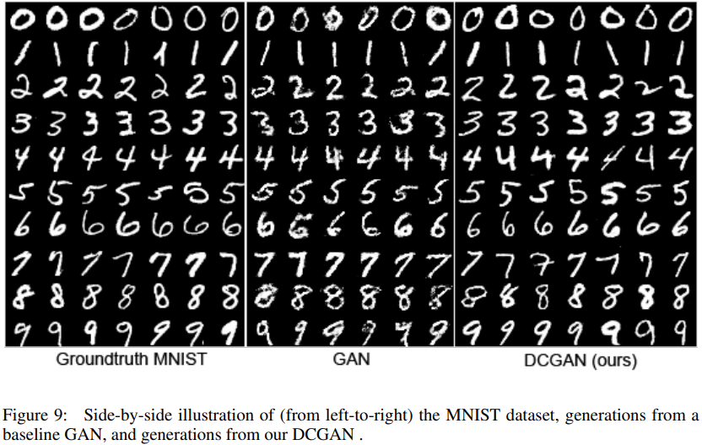
Examples Generated by DCGAN

Slide 18
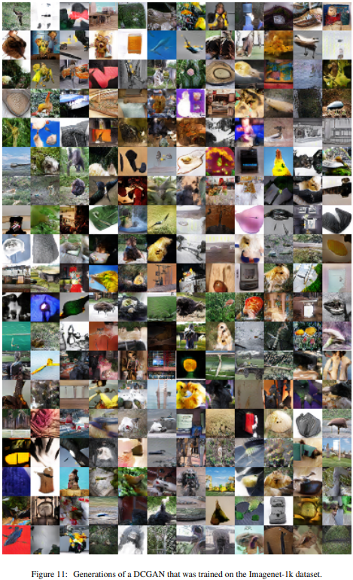
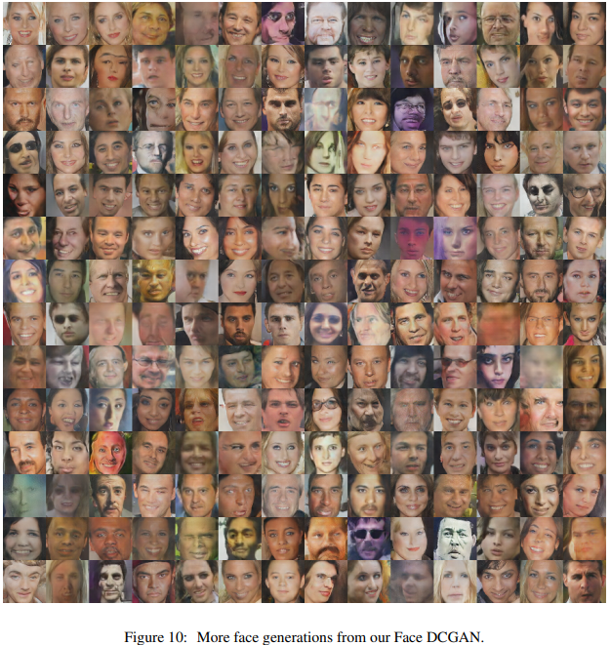
Examples Generated by DCGAN (2)

Slide 19
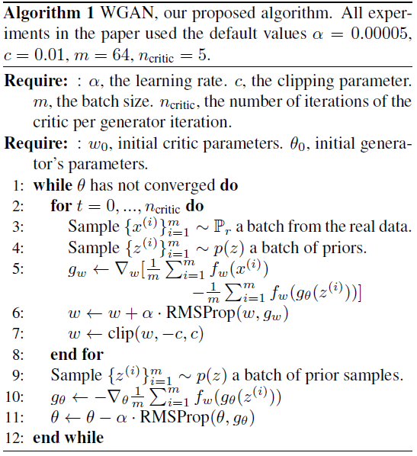
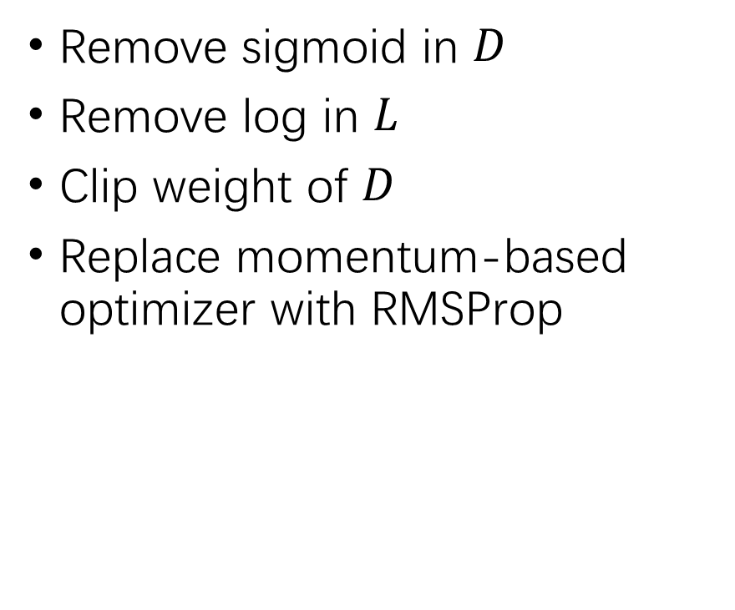
Improved WGAN
Remove sigmoid in $D$
Remove log in $L$
Clip weight of $D$
Replace momentum-based optimizer with RMSProp
Martín Arjovsky, Soumith Chintala, Léon Bottou. Wasserstein Generative Adversarial Networks. ICML 2017: 214-223.

Slide 20
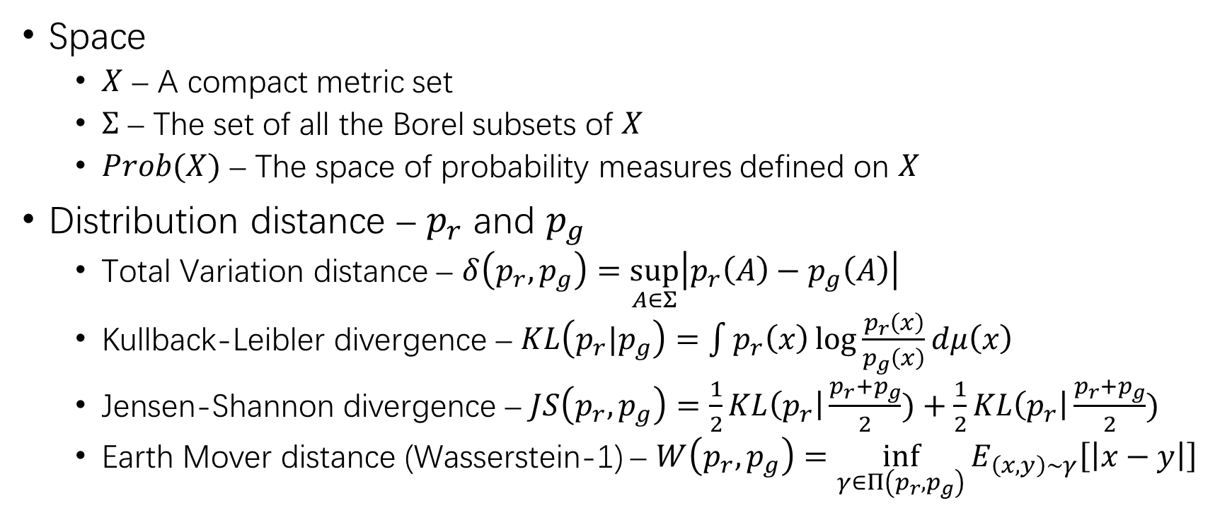
Different Distances
Space
$X$ – A compact metric set
$Σ$ – The set of all the Borel subsets of $X$
$Prob(X)$ – The space of probability measures defined on $X$
Distribution distance – $p_{r}$ and $p_{g}$
Total Variation distance – $δ\left(p_{r},p_{g}\right)=\sup_{A∈Σ}\left|p_{r}\left(A\right)−p_{g}\left(A\right)\right|$
Kullback-Leibler divergence – $KL\left(p_{r}|p_{g}\right)=\int{p_{r}\left(x\right)\log{\frac{p_{r}\left(x\right)}{p_{g}\left(x\right)}}dμ\left(x\right)}$
Jensen-Shannon divergence – $JS\left(p_{r},p_{g}\right)=\frac{1}{2}KL\left(p_{r}\right|\frac{p_{r}+p_{g}}{2})+\frac{1}{2}KL\left(p_{r}\right|\frac{p_{r}+p_{g}}{2})$
Earth Mover distance (Wasserstein-1) – $W\left(p_{r},p_{g}\right)=\inf_{γ∈Π\left(p_{r},p_{g}\right)}{E_{\left(x,y\right)∼γ}\left[\left|x−y\right|\right]}$

Slide 21
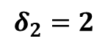
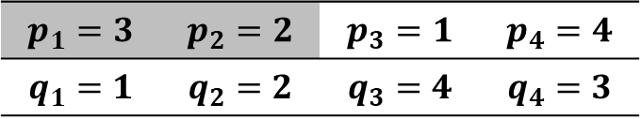
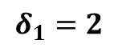
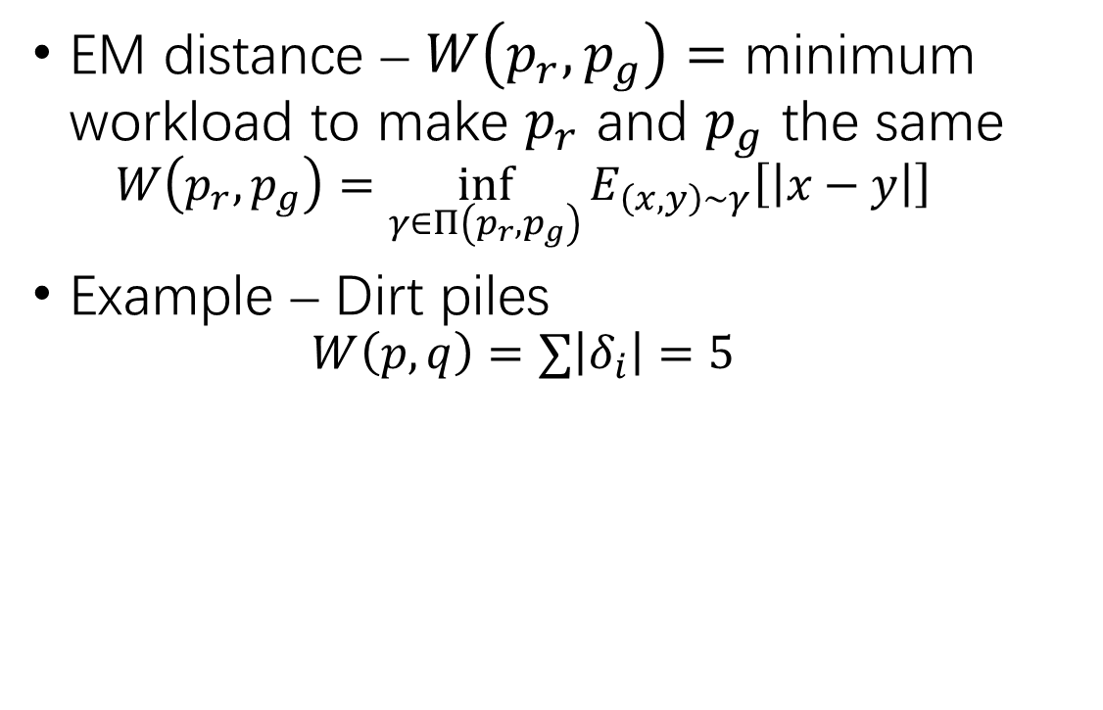
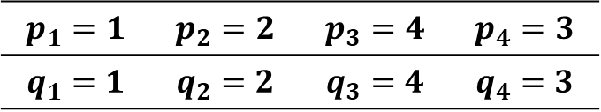
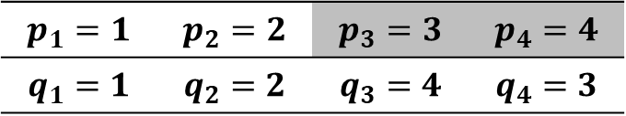
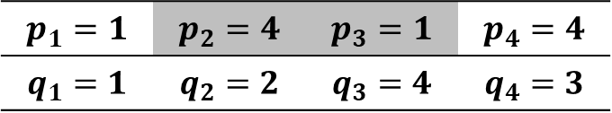
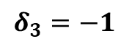
Wasserstein Distance
EM distance – $W\left(p_{r},p_{g}\right)=$ minimum workload to make $p_{r}$ and $p_{g}$ the same
$$W\left(p_{r},p_{g}\right)=\inf_{γ∈Π\left(p_{r},p_{g}\right)}{E_{\left(x,y\right)∼γ}\left[\left|x−y\right|\right]}$$
Example – Dirt piles
$$W\left(p,q\right)=∑\left|δ_{i}\right|=5$$
$$p_{1}=3$$ | $$p_{2}=2$$ | $$p_{3}=1$$ | $$p_{4}=4$$
$$q_{1}=1$$ | $$q_{2}=2$$ | $$q_{3}=4$$ | $$q_{4}=3$$
$$δ_{1}=2$$
$$p_{1}=1$$ | $$p_{2}=4$$ | $$p_{3}=1$$ | $$p_{4}=4$$
$$q_{1}=1$$ | $$q_{2}=2$$ | $$q_{3}=4$$ | $$q_{4}=3$$
$$p_{1}=1$$ | $$p_{2}=2$$ | $$p_{3}=3$$ | $$p_{4}=4$$
$$q_{1}=1$$ | $$q_{2}=2$$ | $$q_{3}=4$$ | $$q_{4}=3$$
$$δ_{2}=2$$
$$p_{1}=1$$ | $$p_{2}=2$$ | $$p_{3}=4$$ | $$p_{4}=3$$
$$q_{1}=1$$ | $$q_{2}=2$$ | $$q_{3}=4$$ | $$q_{4}=3$$
$$δ_{3}=−1$$

Slide 22
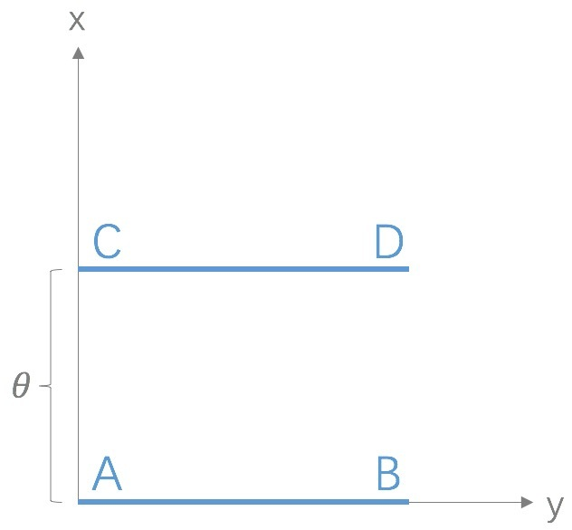
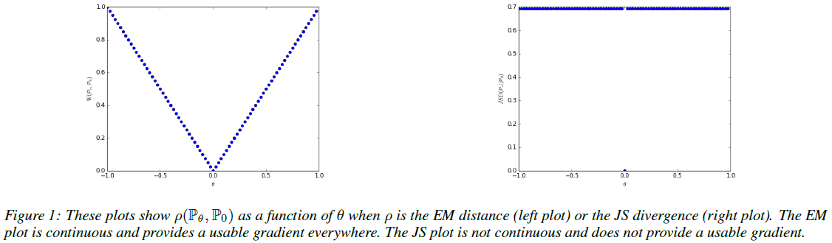
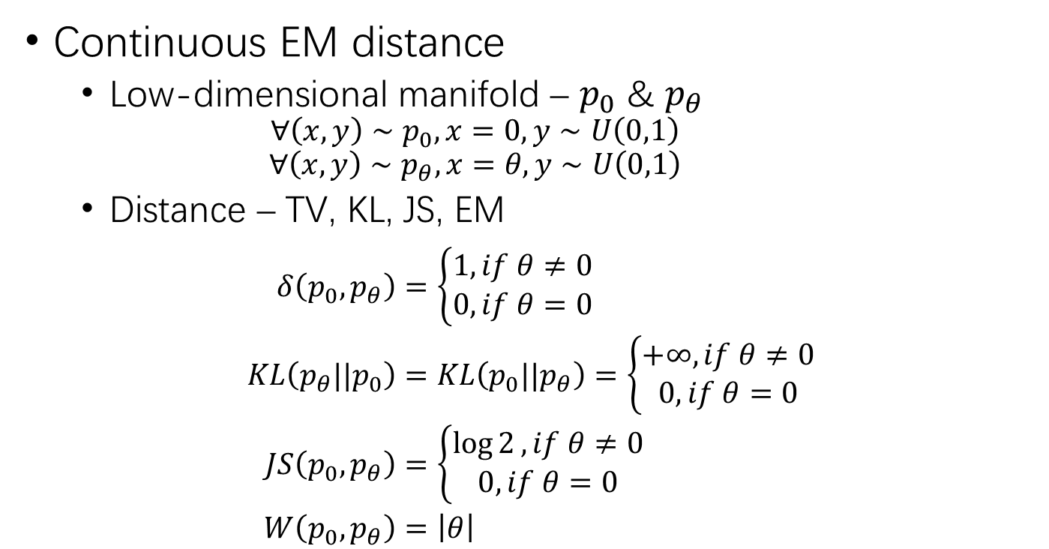
Continuity of Wasserstein Distance
Continuous EM distance
Low-dimensional manifold – $p_{0}$ & $p_{θ}$
$${∀\left(x,y\right)∼p}_{0}, x=0, y∼U\left(0,1\right)$$
$${∀\left(x,y\right)∼p}_{θ}, x=θ, y∼U\left(0,1\right)$$
Distance – TV, KL, JS, EM
$$\begin{aligned}δ\left(p_{0},p_{θ}\right)&=\left\{\begin{aligned}1, if θ≠0 \\ 0, if θ=0\end{aligned}\right. \\ KL\left(p_{θ}||p_{0}\right)&=KL\left(p_{0}||p_{θ}\right)=\left\{\begin{aligned}+∞, if θ≠0 \\ 0, if θ=0\end{aligned}\right. \\ JS\left(p_{0},p_{θ}\right)&=\left\{\begin{aligned}\log{2}, if θ≠0 \\ 0, if θ=0\end{aligned}\right. \\ W\left(p_{0},p_{θ}\right)&=\left|θ\right|\end{aligned}$$
JS
Wasserstein

Slide 23
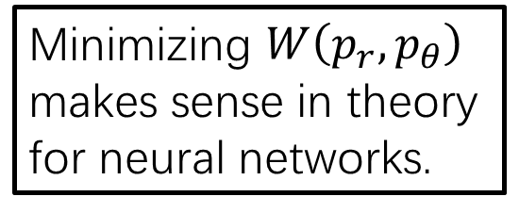
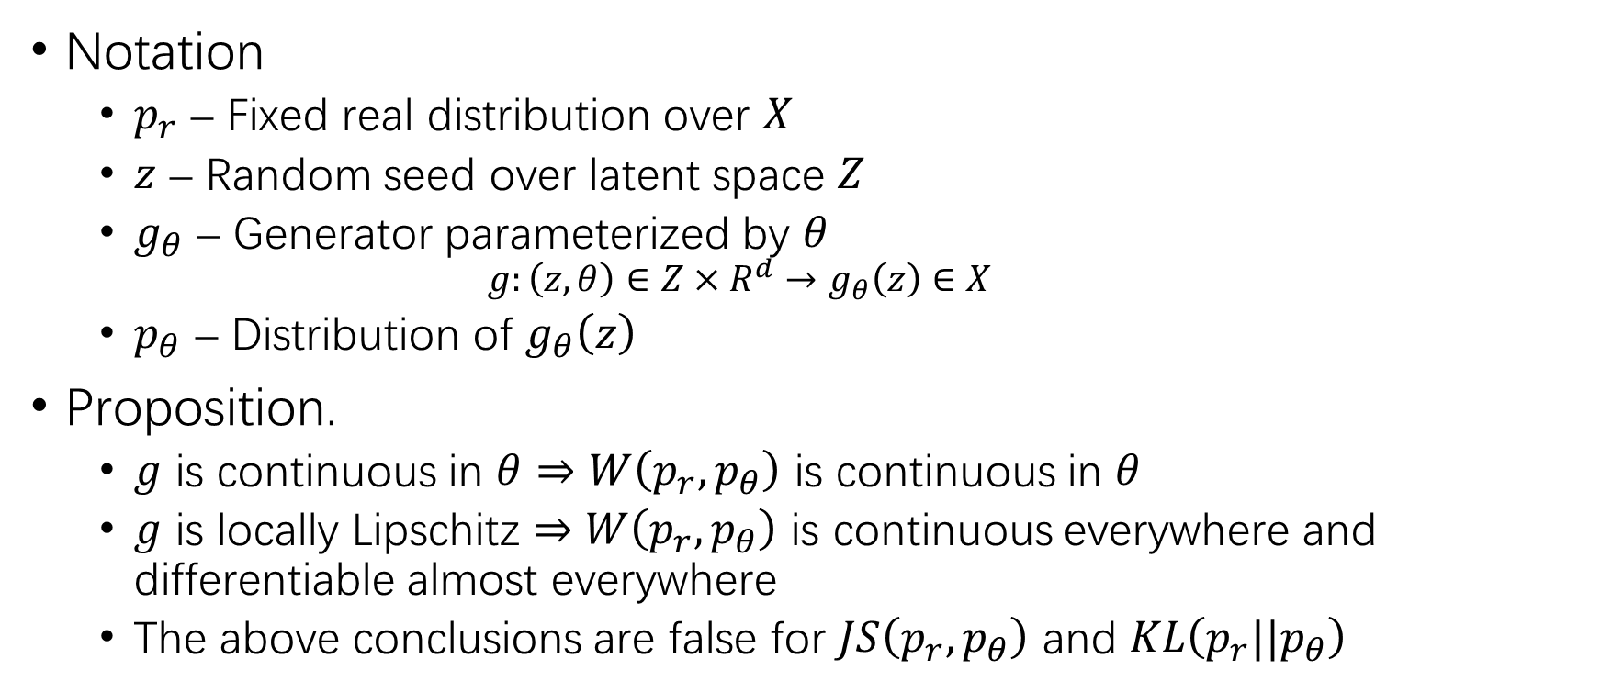
Continuity of Wasserstein Distance (2)
Notation
$p_{r}$ – Fixed real distribution over $X$
$z$ – Random seed over latent space $Z$
$g_{θ}$ – Generator parameterized by $θ$
$$g:\left(z, θ\right)∈Z×R^{d}→g_{θ}\left(z\right)∈X$$
$p_{θ}$ – Distribution of $g_{θ}\left(z\right)$
Proposition.
$g$ is continuous in $θ$ $⇒$ $W\left(p_{r},p_{θ}\right)$ is continuous in $θ$
$g$ is locally Lipschitz $⇒$ $W\left(p_{r},p_{θ}\right)$ is continuous everywhere and differentiable almost everywhere
The above conclusions are false for $JS\left(p_{r},p_{θ}\right)$ and $KL\left(p_{r}||p_{θ}\right)$
Minimizing $W\left(p_{r},p_{θ}\right)$ makes sense in theory for neural networks.

Slide 24
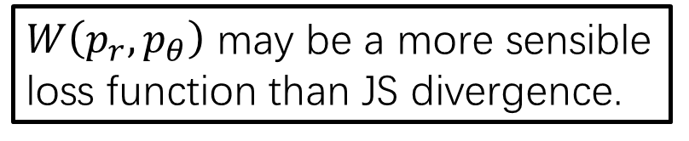
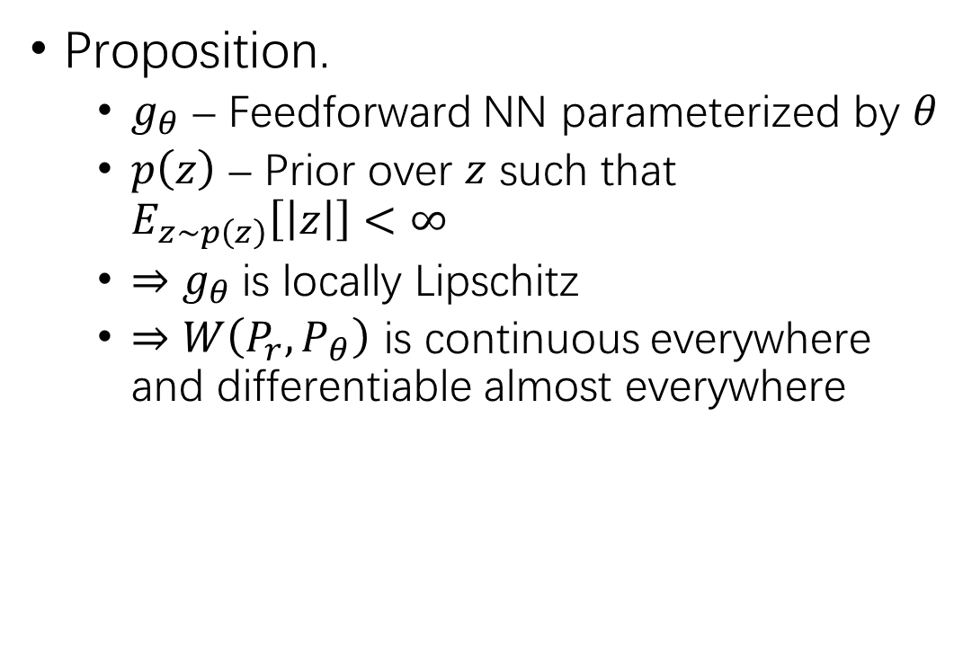
Continuity of Wasserstein Distance (3)
Proposition.
$g_{θ}$ – Feedforward NN parameterized by $θ$
$p\left(z\right)$ – Prior over $z$ such that $E_{z∼p\left(z\right)}\left[\left|z\right|\right]<∞$
$⇒$ $g_{θ}$ is locally Lipschitz
$⇒$ $W\left(P_{r},P_{θ}\right)$ is continuous everywhere and differentiable almost everywhere
$W\left(p_{r},p_{θ}\right)$ may be a more sensible loss function than JS divergence.

Slide 25
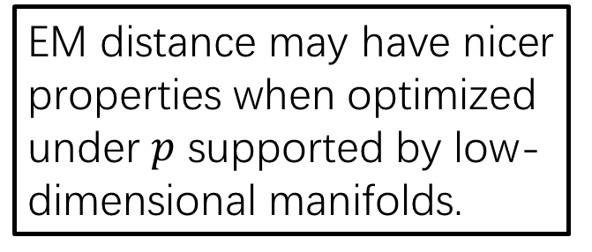
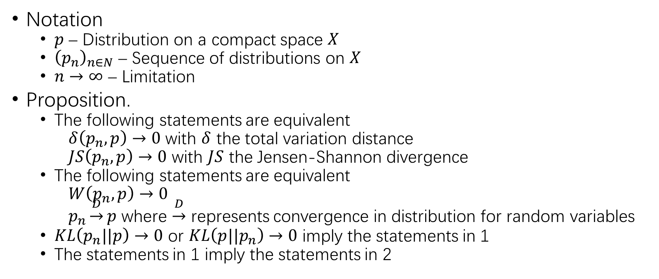
Continuity of Wasserstein Distance (4)
Notation
$p$ – Distribution on a compact space $X$
${\left(p_{n}\right)}_{n∈N}$ – Sequence of distributions on $X$
$n→∞$ – Limitation
Proposition.
The following statements are equivalent
$δ\left(p_{n},p\right)→0$ with $δ$ the total variation distance
$JS\left(p_{n},p\right)→0$ with $JS$ the Jensen-Shannon divergence
The following statements are equivalent
$W\left(p_{n},p\right)→0$
$p_{n}\underset{→}{D}p$ where $\underset{→}{D}$ represents convergence in distribution for random variables
$KL\left(p_{n}||p\right)→0$ or $KL\left(p||p_{n}\right)→0$ imply the statements in 1
The statements in 1 imply the statements in 2
EM distance may have nicer properties when optimized under $p$ supported by low-dimensional manifolds.

Slide 26

Wasserstein GAN
Wasserstein distance
$$W\left(p_{r},p_{g}\right)=\inf_{γ∈Π\left(p_{r},p_{g}\right)}{E_{\left(x,y\right)∼γ}\left[\left|x−y\right|\right]}$$
Kantorovich-Rubinstein duality
$$W\left(p_{r},p_{θ}\right)=\sup_{{\left|f\right|}_{L}≤1}{E_{x∼p_{r}}\left[f(x)\right]−E_{x∼p_{θ}}\left[f\left(x\right)\right]}$$
$K$-Lipschitz discriminator – ${\left\{f_{w}\right\}}_{w∈W}$ is $K$-Lipschitz continuous
$$\max_{w∈W}{E_{x∼P_{r}}\left[f_{w}\left(x\right)\right]−E_{z∼p\left(z\right)}\left[f_{w}\left(g_{θ}\left(z\right)\right)\right]}$$

Slide 27


Wasserstein GAN (2)
Notation
$p_{r}$ – any distribution
$z$ – random variable with density $p$
$p_{θ}$ – the distribution of $g_{θ}\left(z\right)$
Proposition.
$f$ is Lipschitz continuous
$⇒$ There is a solution $f:X→R$ to
$$\max_{||f||_{L}≤1}{E_{x∼P_{r}}\left[f\left(x\right)\right]−E_{x∼P_{θ}}\left[f\left(x\right)\right]}$$
$⇒$ The gradient exists
$$∇_{θ}W\left(P_{r},P_{θ}\right)=−E_{z∼p\left(z\right)}\left[∇_{θ}f\left(g_{θ}\left(z\right)\right)\right]$$
It is feasible to obtain $f$ by back-propagation.

Slide 28

Wasserstein GAN (3)
Assumption
$w∈W$ must be compact
$f_{w}$ must be $K$-Lipschitz
BP may break these assumptions
Weight clipping
Keep $w$ in the compact space
Keep $f_{w}$ to be $K$-Lipschitz
Clipping – $w∈{\left[−c, c\right]}^{l}$

Slide 29




Facing the Challenges of GAN
WGAN vs. GAN
Remove sigmoid in $D$
Remove log in $L$
Clip weight of $D$
Replace momentum-based optimizer with RMSProp
Vanishing gradient
Wasserstein distance is continuous, and does not have a locally saturated point as JS
$D$ must be $K$-Lipschitz
Wasserstein & K-R duality
Weights in $D$ must be compact
Unstable gradient

Slide 30
Facing the Challenges of GAN (2)
Low-dimensional manifold
Wasserstein distance is immune to this problem
Mode collapse
Not any mode collapse found in WGAN

Slide 31

Examples Generated by WGAN
As good as DCGAN
More robust

Slide 32



CGAN
GAN:
$$L\left(D,G\right)\&=E_{x\sim p_{r}\left(x\right)}\left[\log{D\left(x\right)}\right]+E_{z\sim p_{z}\left(z\right)}\left[\log\left(1−D\left(G\left(z\right)\right)\right)\right]$$
Conditional GAN
Label condition
$$L\left(D,G\right)=E_{x\sim p_{r}\left(x\right)}\left[\log{D\left(x|y\right)}\right]+E_{z\sim p_{z}\left(z\right)}\left[\log\left(1−D\left(G\left(z | y\right)|y\right)\right)\right]$$
Mehdi Mirza, Simon Osindero. Conditional Generative Adversarial Nets. CoRR abs/1411.1784 (2014).

Slide 33

Examples Generated by CGAN

Slide 34
More GANs …
Cycle GAN
Jun-Yan Zhu, Taesung Park, Phillip Isola, Alexei A. Efros. Unpaired Image-to-Image Translation Using Cycle-Consistent Adversarial Networks. ICCV 2017: 2242-2251.
f-GAN
Sebastian Nowozin, Botond Cseke, Ryota Tomioka. f-GAN: Training Generative Neural Samplers using Variational Divergence Minimization. NIPS 2016: 271-279.
InfoGAN
Xi Chen, Yan Duan, Rein Houthooft, John Schulman, Ilya Sutskever, Pieter Abbeel. InfoGAN: Interpretable Representation Learning by Information Maximizing Generative Adversarial Nets. NIPS 2016: 2172-2180.
https://github.com/hindupuravinash/the-gan-zoo

Slide 35


Application – CodeBERT
$G$ – Masked language model
[MASK] $⇒$ Predicted token
$D$ – Replaced token detection
Token $⇒$ Original? Reconstructed?
Zhangyin Feng, Daya Guo, Duyu Tang, Nan Duan, Xiaocheng Feng, Ming Gong, Linjun Shou, Bing Qin, Ting Liu, Daxin Jiang, Ming Zhou. CodeBERT: A Pre-Trained Model for Programming and Natural Languages. CoRR abs/2002.08155 (2020)

Slide 36
Variational Auto Encoder

Slide 37

Generative Auto Encoder
Auto Encoder – Discriminative
$$\begin{aligned}φ&:X→Z \\ ψ&:Z→X \\ φ,ψ&=\underset{φ,ψ}{argmin}{{\left|X−\left(ψ∘φ\right)X\right|}^{2}}\end{aligned}$$
Generative AE?

Slide 38

VAE
Generative Model $p\left(x\right)$
Likelihood – $\log{p_{θ}\left(x^{\left(1\right)},⋯,x^{\left(N\right)}\right)}=\sum_{i=1}^{N}{\log{p_{θ}\left(x^{\left(i\right)}\right)}}$
$$\begin{aligned}\log{p_{θ}\left(x^{\left(i\right)}\right)}&=KL\left(q_{φ}\left(z|x^{\left(i\right)}\right)||p_{θ}\left(z|x^{\left(i\right)}\right)\right)+L\left(θ,φ;x^{\left(i\right)}\right) \\ ⇒\log{p_{θ}\left(x\right)}≥L\left(θ,φ;x\right)&=\log{p_{θ}\left(x\right)}−KL\left(q_{φ}\left(z|x\right)||p_{θ}\left(z|x\right)\right) \\ &=\log{p_{θ}\left(x\right)}−E_{q_{φ}\left(z|x\right)}\left[\log{q_{φ}\left(z|x\right)}−\log{p_{θ}\left(z|x\right)}\right] \\ &=E_{q_{φ}\left(z|x\right)}\left[\log{p_{θ}\left(x\right)}+\log{p_{θ}\left(z|x\right)}−\log{q_{φ}\left(z|x\right)}\right] \\ &=E_{q_{φ}\left(z|x\right)}\left[\log{p_{θ}\left(z\right)}+\log{p_{θ}\left(x|z\right)}−\log{q_{φ}\left(z|x\right)}\right] \\ &=E_{q_{φ}\left(z|x\right)}\left[\log{p_{θ}\left(x|z\right)}\right]−KL\left(q_{φ}\left(z|x\right)||p_{θ}\left(z\right)\right)\end{aligned}$$
Diederik P. Kingma, Max Welling. Auto-Encoding Variational Bayes. ICLR 2014.

Slide 39

Variational Bound
Variational Bound – $L\left(θ,φ;x\right)$
$$\log{p_{θ}\left(x\right)}≥L\left(θ,φ;x\right)=E_{q_{φ}\left(z|x\right)}\left[\log{p_{θ}\left(x|z\right)}\right]−KL\left(q_{φ}\left(z|x\right)||p_{θ}\left(z\right)\right)$$
$$\begin{aligned}\max_{θ}{p_{θ}\left(x\right)}&⇒\max_{θ,φ}{L\left(θ,φ;x\right)} \\ &⇒\max_{θ}{E_{q_{φ}\left(z|x\right)}\left[\log{p_{θ}\left(x|z\right)}\right]} and \min_{φ}{KL\left(q_{φ}\left(z|x\right)||p_{θ}\left(z\right)\right)}\end{aligned}$$
Latent space – $p_{θ}\left(z\right)$
Encoder $q\left(z|x\right)$ – Optimize $KL\left(q_{φ}\left(z|x\right)||p_{θ}\left(z\right)\right)$
Decoder $p\left(x|z\right)$ – Optimize $E_{q_{φ}\left(z|x\right)}\left[\log{p_{θ}\left(x|z\right)}\right]$

Slide 40


Variational Auto Encoder
$$\log{p_{θ}\left(x\right)}≥L\left(θ,φ;x\right)=E_{q_{φ}\left(z|x\right)}\left[\log{p_{θ}\left(x|z\right)}\right]−KL\left(q_{φ}\left(z|x\right)||p_{θ}\left(z\right)\right)$$
Encoder
Prior assumption – Standard Gaussian
$$z∼N\left(0,1\right)$$
Objective – Optimize $KL\left(q_{φ}\left(z|x\right)||p_{θ}\left(z\right)\right)≥0$
$$q_{φ}\left(z|x\right)→N\left(0,1\right)$$

Slide 41

Variational Auto Encoder (2)
Decoder
Objective – Optimize $E_{q_{φ}\left(z|x\right)}\left[\log{p_{θ}\left(x|z\right)}\right]$
Sample $z$ from $q_{φ}\left(z|x\right)$
Reconstruct $x$ by $p_{θ}\left(x|z\right)$
Reparameterization trick
Sampling & gradient
Reparameterization
Compute $μ\left(x\right)$ and $Σ\left(x\right)$ of $q_{φ}\left(z|x\right)$
Sample $ε$ from $N\left(0,1\right)$
$$z=ε∘Σ\left(x\right)+μ\left(x\right)$$

Slide 42


Variational Auto Encoder (3)
$$L\left(θ,φ;x\right)=E_{q_{φ}\left(z|x\right)}\left[\log{p_{θ}\left(x|z\right)}\right]−KL\left(q_{φ}\left(z|x\right)||p_{θ}\left(z\right)\right)$$

Slide 43


Examples Generated by VAE

Slide 44


WAE
Mode collapse in VAE
$$E_{q_{φ}\left(z|x\right)}\left[\log{p_{θ}\left(x|z\right)}\right]−KL\left(q_{φ}\left(z|x\right)||p_{θ}\left(z\right)\right)$$
$⇒$ $q_{φ}\left(z|x\right)→p_{θ}\left(z\right)$
WAE
$Q_{φ}\left(z\right)=E_{p_{θ}\left(z\right)}\left[Q_{φ}\left(z|x\right)\right]→p_{θ}\left(z\right)$
Ilya O. Tolstikhin, Olivier Bousquet, Sylvain Gelly, Bernhard Schölkopf. Wasserstein Auto-Encoders. CoRR abs/1711.01558 (2017).

Slide 45

Optimal Transport
$f$-divergence – Low-dimensional manifolds $⇒$ vanishing gradient
$$D_{f}\left(p||q\right)=\int{q\left(x\right)f\left(\frac{p\left(x\right)}{q\left(x\right)}\right)dx}, where f is convex and f\left(1\right)=0$$
KL divergence – $f\left(x\right)=−\log{x}$
OT cost – Better behavior
$$W_{c}\left(p_{X},p_{G}\right)=\inf_{Τ∈P\left(X∼P_{X},Y∼P_{G}\right)}{E_{\left(X,Y\right)∼Τ}}\left[c\left(X,Y\right)\right]$$
$p$-Wasserstein distance – $c\left(X,Y\right)=d^{p}\left(X,Y\right)$ and $p≥1$

Slide 46


Optimal Transport (2)
Notation
$G:Z→X$ – Generator
$P_{G}\left(X|Z\right)$ – Deterministic distribution
$P_{G}\left(x\right)=\int_{Z}{P_{G}\left(x|z\right)P_{z}\left(z\right)dz}$
$Q_{Z}$ – Marginal distribution of $Z$ when $X∼P_{X}$ and $Z∼Q\left(Z|X\right)$
Proposition.
$$\inf_{Τ∈P\left(X∼P_{X},Y∼P_{G}\right)}{E_{\left(X,Y\right)∼Τ}}\left[c\left(X,Y\right)\right]=\inf_{Q:Q_{Z}=P_{Z}}{E_{P_{X}}E_{Q\left(Z|X\right)}\left[c\left(x,G\left(z\right)\right)\right]}$$
① No need to optimize over coupling $X$ and $Y$.
② Optimizing over random encoder $Q(Z|X)$ is feasible.

Slide 47

Wasserstein Auto Encoder
Loss function
$$\begin{aligned}D_{WAE}\left(P_{X},P_{G}\right)&=\inf_{Τ∈P\left(X∼P_{X},Y∼P_{G}\right)}{E_{\left(X,Y\right)∼Τ}}\left[c\left(X,Y\right)\right] \\ &=\inf_{Q:Q_{Z}=P_{Z}}{E_{P_{X}}E_{Q\left(Z|X\right)}\left[c\left(x,G\left(z\right)\right)\right]} \\ &=\inf_{Q\left(Z|X\right)∈Q}{E_{P_{X}}E_{Q\left(Z|X\right)}\left[c\left(x,G\left(z\right)\right)\right]}+λ⋅D_{z}\left(Q_{Z},P_{Z}\right)\end{aligned}$$
$Q$ – Any nonparametric set of probabilistic encoders
$D_{Z}$ – Arbitrary divergence between $Q_{Z}$ and $P_{Z}$
Difference from VAE – Non-random deterministic encoder $Q(Z|X)$

Slide 48


Wasserstein Auto Encoder (2)
GAN-based WAE
$$D_{Z}\left(Q_{Z},P_{Z}\right)=D_{JS}\left(Q_{Z},P_{Z}\right)$$
Adversary – $D$ in the latent space $Z$

Slide 49


Wasserstein Auto Encoder (3)
MMD-based $D_{Z}$
$$D_{Z}\left(Q_{Z},P_{Z}\right)=MMD_{k}\left(P_{Z},Q_{Z}\right)$$
Maximum mean discrepancy – Difference between $p$ and $q$
$$MMD\left[F,p,q\right]=\sup_{f∈F}\left(E_{p}\left[f\left(x\right)\right]−E_{q}\left[f\left(x\right)\right]\right)$$
$F$ – Norm ball in RKHS (Reproducing Kernel Hilbert Space)

Slide 50

Examples Generated by WAE

Slide 51

Examples Generated by WAE (2)

Slide 52
Diffusion Model

Slide 53



Diffusion Model
Forward diffusion process – Add noise iteratively
Data $→⋯→$ noise
Reverse generative process – Denoise iteratively
Noise $→⋯→$ data
Lilian Weng. What are Diffusion Models? https://lilianweng.github.io/posts/2021-07-11-diffusion-models/

Slide 54

Decomposing Diffusion Model
Forward diffusion – $q\left(x_{t}|x_{t−1}\right)$ $⇒$ $q\left(x_{t}|x_{0}\right)$
Reverse diffusion – $q\left(x_{t−1}|x_{t}\right)$ $⇒$ $q\left(x_{t−1}|x_{t},x_{0}\right)$
Model – train $p_{θ}\left(x_{t−1}|x_{t}\right)$ to simulate $q\left(x_{t−1}|x_{t}\right)$
Loss – VLB

Slide 55

Forward Diffusion Process
Forward diffusion – Add small amount of Gaussian noise to the sample $x_{0}$ in $T$ steps, producing $x_{1},⋯,x_{T}$
Real data distribution – $x_{0}∼q\left(x\right)$
Step sizes – ${\left\{β_{t}∈\left(0,1\right)\right\}}_{t=1}^{T}$
Each step – $q\left(x_{t}|x_{t−1}\right)=N\left(x_{t};\sqrt{1−β_{t}}x_{t−1},β_{t}I\right)$
$T→∞$ – $x_{T}$ is equivalent to an isotropic Gaussian distribution

Slide 56






Forward Diffusion Process (2)
Reparameterization trick
Each step – $x_{t}∼N\left(\sqrt{1−β_{t}}x_{t−1},β_{t}I\right)$
$$x_{t}=\sqrt{α_{t}}x_{t−1}+\sqrt{1−α_{t}}ε_{t−1} \\ =\sqrt{α_{t}}\left(\sqrt{α_{t−1}}x_{t−2}+\sqrt{1−α_{t−1}}ε_{t−2}\right)+\sqrt{1−α_{t}}ε_{t−1} \\ =\sqrt{α_{t}α_{t−1}}x_{t−2}+\sqrt{α_{t}−α_{t}α_{t−1}}ε_{t−2}+\sqrt{1−α_{t}}ε_{t−1} \\ =\sqrt{α_{t}α_{t−1}}x_{t−2}+\sqrt{1−α_{t}α_{t−1}}{\overline{ε}}_{t−2} \\ =⋯ \\ =\sqrt{{\overline{α}}_{t}}x_{0}+\sqrt{1−{\overline{α}}_{t}}ε$$
$$α_{t}=1−β_{t}$$
$$ε_{t−1},ε_{t−2},⋯∼N\left(0,I\right)$$
$$MERGE\left(N\left(0,σ_{1}^{2}I\right),N\left(0,σ_{2}^{2}I\right)\right)$$
$$⇒N\left(0,\left(σ_{1}^{2}+σ_{2}^{2}\right)I\right)$$
${\overline{ε}}_{t−2}$ merges $ε_{t−1}$ and $ε_{t−2}$
$${\overline{α}}_{t}=\prod_{i=1}^{t}{α_{i}}$$

Slide 57

Forward Diffusion Process (3)
Forward diffusion
$$x_{t}=\sqrt{{\overline{α}}_{t}}x_{0}+\sqrt{1−{\overline{α}}_{t}}ε$$
Therefore, for any $t$
$$q\left(x_{t}|x_{0}\right)=N\left(x_{t};\sqrt{{\overline{α}}_{t}},\left(1−{\overline{α}}_{t}\right)I\right)=N\left(x_{t};\sqrt{\prod_{i=1}^{t}{α_{i}}},\left(1−\prod_{i=1}^{t}{α_{i}}\right)I\right)$$
Usually $β_{1}<β_{2}<⋯<β_{T}$
$${\overline{α}}_{1}>{\overline{α}}_{2}>⋯>{\overline{α}}_{T}→0$$
$$x_{T}∼N\left(0,I\right)$$

Slide 58

Reverse Diffusion Process
Reverse diffusion – Sample from $q\left(x_{t−1} | x_{t}\right)$ to recreate the true sample from the Gaussian noise input $x_{T}$
Gaussian input – $x_{T}∼N\left(0,I\right)$
Gaussian assumption – If $β_{t}$ is small enough, $q\left(x_{t−1}|x_{t}\right)$ will be Gaussian
Model estimation – $q\left(x_{t−1}|x_{t}\right)$ is hard to estimation, therefore we train a model $p_{θ}$ to approximate $q\left(x_{t−1}|x_{t}\right)$ to run the reverse process
$$p_{θ}\left(x_{t−1}|x_{t}\right)=N\left(x_{t−1};μ_{θ}\left(x_{t},t\right),Σ_{θ}\left(x_{t},t\right) \right)$$
$$p_{θ}\left(x_{0:T}\right)=p\left(x_{T}\right)\prod_{t=1}^{T}{p_{θ}\left(x_{t−1}|x_{t}\right)}$$

Slide 59


Reverse Diffusion Process (2)
$$q\left(x_{t}|x_{0}\right)=N\left(x_{t};\sqrt{{\overline{α}}_{t}},\left(1−{\overline{α}}_{t}\right)I\right) \\ q\left(x_{t}|x_{t−1}\right)=N\left(x_{t};\sqrt{α_{t}}x_{t−1},\left(1−α_{t}\right) I\right)$$
Tractable $q\left(x_{t−1} | x_{t}\right)$ when conditioned on $x_{0}$ – $q\left(x_{t−1}|x_{t},x_{0}\right)=N\left(x_{t−1};\tilde{μ}\left(x_{t},x_{0}\right),\tilde{β}I\right)$
$$q\left(x_{t−1}|x_{t},x_{0}\right)=q\left(x_{t}|x_{t−1},x_{0}\right)⋅\frac{q\left(x_{t−1}|x_{0}\right)}{q\left(x_{t}|x_{0}\right)}∝\exp\left(−\frac{1}{2}\left(\frac{{\left(x_{t}−\sqrt{α_{t}}x_{t−1}\right)}^{2}}{β_{t}}+\frac{{\left(x_{t−1}−\sqrt{{\overline{α}}_{t−1}}x_{0}\right)}^{2}}{1−{\overline{α}}_{t−1}}−\frac{{\left(x_{t}−\sqrt{{\overline{α}}_{t}}x_{0}\right)}^{2}}{1−{\overline{α}}_{t}}\right)\right)=\exp\left(−\frac{1}{2}\left(\frac{x_{t}^{2}−2\sqrt{α_{t}}x_{t}x_{t−1}+α_{t}x_{t−1}^{2}}{β_{t}}+\frac{x_{t−1}^{2}−2\sqrt{{\overline{α}}_{t−1}}x_{0}x_{t−1}+{\overline{α}}_{t−1}x_{0}^{2}}{1−{\overline{α}}_{t−1}}−\frac{{\left(x_{t}−\sqrt{{\overline{α}}_{t}}x_{0}\right)}^{2}}{1−{\overline{α}}_{t}}\right)\right)=\exp\left(−\frac{1}{2}\left(\left(\frac{α_{t}}{β_{t}}+\frac{1}{1−{\overline{α}}_{t−1}}\right)x_{t−1}^{2}−\left(\frac{2\sqrt{α_{t}}}{β_{t}}x_{t}+\frac{2\sqrt{{\overline{α}}_{t−1}}}{1−{\overline{α}}_{t−1}}x_{0}\right)x_{t−1}+C\left(x_{t},x_{0}\right)\right)\right)$$

Slide 60


Reverse Diffusion Process (3)
Tractable $q\left(x_{t−1} | x_{t}\right)$ when conditioned on $x_{0}$ – $N\left(x_{t−1};\tilde{μ}\left(x_{t},x_{0}\right),\tilde{β}I\right)$
$$\tilde{β}=\frac{1}{\left(\frac{α_{t}}{β_{t}}+\frac{1}{1−{\overline{α}}_{t−1}}\right)}=\frac{1−{\overline{α}}_{t−1}}{1−{\overline{α}}_{t}}β_{t}$$
$$\tilde{μ}\left(x_{t},x_{0}\right)=\left(\frac{\sqrt{α_{t}}}{β_{t}}x_{t}+\frac{\sqrt{{\overline{α}}_{t−1}}}{1−{\overline{α}}_{t−1}}x_{0}\right)⋅\frac{1}{\left(\frac{α_{t}}{β_{t}}+\frac{1}{1−{\overline{α}}_{t−1}}\right)} \\ =\left(\frac{\sqrt{α_{t}}}{β_{t}}x_{t}+\frac{\sqrt{{\overline{α}}_{t−1}}}{1−{\overline{α}}_{t−1}}x_{0}\right)\frac{1−{\overline{α}}_{t−1}}{1−{\overline{α}}_{t}}β_{t} \\ =\frac{\sqrt{α_{t}}\left(1−{\overline{α}}_{t−1}\right)}{1−{\overline{α}}_{t}}x_{t}+\frac{\sqrt{{\overline{α}}_{t−1}}β_{t}}{1−{\overline{α}}_{t}}x_{0}$$
$$q\left(x_{t−1}|x_{t},x_{0}\right)∝\exp\left(−\frac{1}{2}\left(\left(\frac{α_{t}}{β_{t}}+\frac{1}{1−{\overline{α}}_{t−1}}\right)x_{t−1}^{2}−\left(\frac{2\sqrt{α_{t}}}{β_{t}}x_{t}+\frac{2\sqrt{{\overline{α}}_{t−1}}}{1−{\overline{α}}_{t−1}}x_{0}\right)x_{t−1}+C\right)\right)$$

Slide 61



Reverse Diffusion Process (4)
$$\tilde{β}=\frac{1−{\overline{α}}_{t−1}}{1−{\overline{α}}_{t}}β_{t} \\ \tilde{μ}\left(x_{t},x_{0}\right)=\frac{\sqrt{α_{t}}\left(1−{\overline{α}}_{t−1}\right)}{1−{\overline{α}}_{t}}x_{t}+\frac{\sqrt{{\overline{α}}_{t−1}}β_{t}}{1−{\overline{α}}_{t}}x_{0}$$
Tractable $q\left(x_{t−1} | x_{t}\right)$ when conditioned on $x_{0}$ – $N\left(x_{t−1};\tilde{μ}\left(x_{t},x_{0}\right),\tilde{β}I\right)$
$$x_{t}=\sqrt{{\overline{α}}_{t}}x_{0}+\sqrt{1−{\overline{α}}_{t}}ε⇒x_{0}=\frac{1}{\sqrt{{\overline{α}}_{t}}}\left(x_{t}−\sqrt{1−{\overline{α}}_{t}}ε\right)$$
$$\tilde{μ}\left(x_{t},x_{0}\right)={\tilde{μ}}_{t}=\frac{\sqrt{α_{t}}\left(1−{\overline{α}}_{t−1}\right)}{1−{\overline{α}}_{t}}x_{t}+\frac{\sqrt{{\overline{α}}_{t−1}}β_{t}}{1−{\overline{α}}_{t}}\frac{1}{\sqrt{{\overline{α}}_{t}}}\left(x_{t}−\sqrt{1−{\overline{α}}_{t}}ε\right) \\ =\frac{\sqrt{α_{t}}\left(1−{\overline{α}}_{t−1}\right)}{1−{\overline{α}}_{t}}x_{t}+\frac{\left(1−α_{t}\right)}{1−{\overline{α}}_{t}}\frac{1}{\sqrt{α_{t}}}\left(x_{t}−\sqrt{1−{\overline{α}}_{t}}ε\right) \\ =\frac{1}{\sqrt{α}}\left(x_{t}−\frac{1−α_{t}}{\sqrt{1−{\overline{α}}_{t}}}ε_{t}\right)$$
$$\frac{\sqrt{α_{t}}\left(1−{\overline{α}}_{t−1}\right)}{1−{\overline{α}}_{t}}+\frac{\left(1−α_{t}\right)}{1−{\overline{α}}_{t}}\frac{1}{\sqrt{α_{t}}} \\ =\frac{\left(1−{\overline{α}}_{t−1}\right)α_{t}+\left(1−α_{t}\right)}{\left(1−{\overline{α}}_{t}\right)\sqrt{α_{t}}} \\ =\frac{α_{t}−{\overline{α}}_{t} +1−α_{t}}{\left(1−{\overline{α}}_{t}\right)\sqrt{α_{t}}} \\ =\frac{1}{\sqrt{α_{t}}}$$

Slide 62

Variational Lower Bound
Max likelihood
$$\max_{θ}{\log{p_{θ}\left(x_{0}\right)}}$$
Variational lower bound
$$−\log{p_{θ}\left(x_{0}\right)}≤−\log{p_{θ}\left(x_{0}\right)+KL\left(q\left(x_{1:T}|x_{0}\right)||p_{θ}\left(x_{1:T}|x_{0}\right)\right)} \\ =−\log{p_{θ}\left(x_{0}\right)}+E_{x_{1:T}∼q\left(x_{1:T}|x_{0}\right)}\left[\log{\frac{q\left(x_{1:T}|x_{0}\right)}{{p_{θ}\left(x_{0:T}\right)}/{p_{θ}\left(x_{0}\right)}}}\right] \\ =−\log{p_{θ}\left(x_{0}\right)}+E_{q}\left[\log{\frac{q\left(x_{1:T}|x_{0}\right)}{p_{θ}\left(x_{0:T}\right)}}+\log{p_{θ}\left(x_{0}\right)}\right] \\ =E_{q}\left[\log{\frac{q\left(x_{1:T}|x_{0}\right)}{p_{θ}\left(x_{0:T}\right)}}\right]$$
$$L_{CE}=−E_{q\left(x_{0}\right)}\log{p_{θ}\left(x_{0}\right)}≤E_{q\left(x_{0:T}\right)}\log{\frac{q\left(x_{1:T}|x_{0}\right)}{p_{θ}\left(x_{0:T}\right)}}=L_{VLB}$$

Slide 63


Variational Lower Bound (2)
Variational lower bound – Jensen’s Inequality
$$L_{CE}=−E_{q\left(x_{0}\right)}\log{p_{θ}\left(x_{0}\right)} \\ =−E_{q\left(x_{0}\right)}\log\left(\int{p_{θ}\left(x_{0:T}\right)dx_{1:T}}\right) \\ =−E_{q\left(x_{0}\right)}\log\left(\int{q\left(x_{1:T}|x_{0}\right)\frac{p_{θ}\left(x_{0:T}\right)}{q\left(x_{1:T}|x_{0}\right)}dx_{1:T}}\right) \\ =−E_{q\left(x_{0}\right)}\log\left(E_{q\left(x_{1:T}|x_{0}\right)}\frac{p_{θ}\left(x_{0:T}\right)}{q\left(x_{1:T}|x_{0}\right)}\right) \\ ≤−E_{q\left(x_{0:T}\right)}\log{\frac{p_{θ}\left(x_{0:T}\right)}{q\left(x_{1:T}|x_{0}\right)}}=E_{q\left(x_{0:T}\right)}\log{\frac{q\left(x_{1:T}|x_{0}\right)}{p_{θ}\left(x_{0:T}\right)}}=L_{VLB}$$
$$φ\left(E\left[X\right]\right)≤E\left[φ\left(X\right)\right]$$

Slide 64

Variational Lower Bound (3)
$$L_{VLB}=E_{q\left(x_{0:T}\right)}\log{\frac{q\left(x_{1:T}|x_{0}\right)}{p_{θ}\left(x_{0:T}\right)}} \\ =E_{q}\log{\frac{\prod_{t=1}^{T}{q\left(x_{t}|x_{t−1}\right)}}{p_{θ}\left(x_{T}\right)\prod_{t=1}^{T}{p_{θ}\left(x_{t−1}|x_{t}\right)}}} \\ =E_{q}\left[−\log{p_{θ}\left(x_{T}\right)}+\sum_{t=1}^{T}{\log{\frac{q\left(x_{t}|x_{t−1}\right)}{p_{θ}\left(x_{t−1}|x_{t}\right)}}}\right] \\ =E_{q}\left[−\log{p_{θ}\left(x_{T}\right)}+\sum_{t=2}^{T}{\log{\frac{q\left(x_{t−1}|x_{t},x_{0}\right)}{p_{θ}\left(x_{t−1}|x_{t}\right)}}}+\sum_{t=2}^{T}{\log{\frac{q\left(x_{t}|x_{0}\right)}{q\left(x_{t−1}|x_{0}\right)}}}+\log{\frac{q\left(x_{1}|x_{0}\right)}{p_{θ}\left(x_{0}|x_{1}\right)}}\right] \\ =E_{q}\left[−\log{p_{θ}\left(x_{T}\right)}+\sum_{t=2}^{T}{\log{\frac{q\left(x_{t−1}|x_{t},x_{0}\right)}{p_{θ}\left(x_{t−1}|x_{t}\right)}}}+\log{\frac{q\left(x_{T}|x_{0}\right)}{q\left(x_{1}|x_{0}\right)}}+\log{\frac{q\left(x_{1}|x_{0}\right)}{p_{θ}\left(x_{0}|x_{1}\right)}}\right] \\ =E_{q}\left[\sum_{t=2}^{T}{\log{\frac{q\left(x_{t−1}|x_{t},x_{0}\right)}{p_{θ}\left(x_{t−1}|x_{t}\right)}}}+\log{\frac{q\left(x_{T}|x_{0}\right)}{p_{θ}\left(x_{0}|x_{1}\right)p_{θ}\left(x_{T}\right)}}\right] \\ =E_{q}\left[KL\left(q\left(x_{T}|x_{0}\right)||p_{θ}\left(x_{T}\right)\right)+\sum_{t=2}^{T}{KL\left(q\left(x_{t−1}|x_{t},x_{0}\right)||p_{θ}\left(x_{t−1}|x_{t}\right)\right)}−\log{p_{θ}\left(x_{0}|x_{1}\right)}\right]$$

Slide 65


Variational Lower Bound (4)
VLB component – $L_{VLB}=L_{T}+L_{T−1}+⋯+L_{0}$
$L_{T}=KL\left(q\left(x_{T}|x_{0}\right)||p_{θ}\left(x_{T}\right)\right)$ – Constant
$L_{t}=KL\left(q\left(x_{t}|x_{t+1},x_{0}\right)||p_{θ}\left(x_{t}|x_{t+1}\right)\right)$ – Model $q\left(x_{t}|x_{t+1},x_{0}\right)$ with $p_{θ}\left(x_{t}|x_{t+1}\right)$
$L_{0}=−\log{p_{θ}\left(x_{0}|x_{1}\right)}$ – Modeled by a separate discrete decoder
$$L_{VLB}=E_{q}\left[KL\left(q\left(x_{T}|x_{0}\right)||p_{θ}\left(x_{T}\right)\right)+\sum_{t=2}^{T}{KL\left(q\left(x_{t−1}|x_{t},x_{0}\right)||p_{θ}\left(x_{t−1}|x_{t}\right)\right)}−\log{p_{θ}\left(x_{0}|x_{1}\right)}\right]$$

Slide 66



Parameterization of $L_{t}$
Goal – $q\left(x_{t−1}|x_{t},x_{0}\right)=N\left(x_{t−1};{\tilde{μ}}_{t},{\tilde{β}}_{t}I\right)$
Model – $p_{θ}\left(x_{t−1}|x_{t}\right)=N\left(x_{t−1};μ_{θ}\left(x_{t},t\right),Σ_{θ}\left(x_{t},t\right)\right)$
Training – $μ_{θ}→{\tilde{μ}}_{t}=\frac{1}{\sqrt{α}}\left(x_{t}−\frac{1−α_{t}}{\sqrt{1−{\overline{α}}_{t}}}ε_{t}\right)$
$$L_{t}=E_{x_{0},ε}\left[\frac{1}{2{\left|Σ_{θ}\left(x_{t},t\right)\right|}_{2}^{2}}{\left|{\tilde{μ}}_{t}\left(x_{t},x_{0}\right)−μ_{θ}\left(x_{t},t\right)\right|}^{2}\right] \\ =E_{x_{0},ε}\left[\frac{1}{2{\left|Σ_{θ}\left(x_{t},t\right)\right|}_{2}^{2}}{\left|\frac{1}{\sqrt{α}}\left(x_{t}−\frac{1−α_{t}}{\sqrt{1−{\overline{α}}_{t}}}ε_{t}\right)−\frac{1}{\sqrt{α}}\left(x_{t}−\frac{1−α_{t}}{\sqrt{1−{\overline{α}}_{t}}}ε_{θ}\left(x_{t},t\right)\right)\right|}^{2}\right] \\ =E_{x_{0},ε}\left[\frac{{\left(1−α_{t}\right)}^{2}}{2α_{t}\left(1−{\overline{α}}_{t}\right){\left|Σ_{θ}\right|}_{2}^{2}}{\left|ε_{t}−ε_{θ}\left(x_{t},t\right)\right|}^{2}\right] \\ =E_{x_{0},ε}\left[\frac{{\left(1−α_{t}\right)}^{2}}{2α_{t}\left(1−{\overline{α}}_{t}\right){\left|Σ_{θ}\right|}_{2}^{2}}{\left|ε_{t}−ε_{θ}\left(\sqrt{{\overline{α}}_{t}}x_{0}+\sqrt{1−{\overline{α}}_{t}}ε_{t},t\right)\right|}^{2}\right]$$
$$x_{t}=\sqrt{{\overline{α}}_{t}}x_{0}+\sqrt{1−{\overline{α}}_{t}}ε_{t}$$

Slide 67



Parameterization of $L_{t}$ (2)
$$L_{t}=E_{t∼\left[1−T\right],x_{0},ε_{t}}\left[\frac{{\left(1−α_{t}\right)}^{2}}{2α_{t}\left(1−{\overline{α}}_{t}\right){\left|Σ_{θ}\right|}_{2}^{2}}{\left|ε_{t}−ε_{θ}\left(\sqrt{{\overline{α}}_{t}}x_{0}+\sqrt{1−{\overline{α}}_{t}}ε_{t},t\right)\right|}^{2}\right]$$
Simplification – Ignore the weighting term
$$L_{t}=L_{t}^{simple}+C \\ =E_{t∼\left[1−T\right],x_{0},ε_{t}}\left[{\left|ε_{t}−ε_{θ}\left(\sqrt{{\overline{α}}_{t}}x_{0}+\sqrt{1−{\overline{α}}_{t}}ε_{t},t\right)\right|}^{2}\right]+C$$
Training & Inference

Slide 68
Adversarial Learning

Slide 69




Powerfulness of Deep Learning
ImageNet
ResNet has outperformed human beings
SQuAD
R-Net has outperformed human beings
Go
AlphaGo has defeated human players
StarCraft 2
AlphaStar has defeated human players
… …

Slide 70



Adversarial Example
Straight
Left
Right
Adversarial perturbation
Minor – Imperceptible to human
Fatal – Misleading the model
Adversarial example
Similar to the original example
Mislead the model to wrong behaviors
Adversarial attack
Procedure to find adversarial examples

Slide 71

Adversarial Example (2)
Perturbation $δ$
Minor – Imperceptible to human & semantic preserving
Constraint – $L_{p}$ norm $⇔$ ${\left|δ\right|}_{p}≤ε$
Adversarial robustness
Robust model $f$ $⇒$ correct prediction under any perturbation $δ$
$$f\left(x+δ\right)=f\left(x\right)=y, where {\left|δ\right|}_{p}≤ε$$
Adversarial example
Adversarial perturbation $\hat{δ}$ $⇒$ erroneous prediction $\hat{y}≠y$
$$f\left(x+\hat{δ}\right)=\hat{y}≠y, where {\left|\hat{δ}\right|}_{p}≤ε$$

Slide 72

Adversarial Robustness
Minimax objective
$$\min_{Θ_{f}}{\sum_{\left(x,y\right)∈D }{\max_{{\left|δ\right|}_{p}≤ε}{J\left(f\left(x+δ\right),y\right)}}}$$
Adversarial attack – Inner max
Adversarial training – Outer min

Slide 73

Adversarial Attack
Inner max – Obtain $\hat{δ}$
$$\begin{aligned}Untargeted:&\max_{{\left|δ\right|}_{p}≤ε}{J\left(f\left(x+δ\right),y\right)} \\ Targeted:&\max_{{\left|δ\right|}_{p}≤ε}{J\left(f\left(x+δ\right),y\right)−J\left(f\left(x+δ\right),\hat{y}\right)}\end{aligned}$$
Lower bound – Obtain adversarial example
Exact solution – NP hard problem
Upper bound – Interval bound propagation

Slide 74






Adversarial Attack (2)
FGSM
GD – Iterative gradient descent (ascent)
$${\hat{x}}_{i}={\hat{x}}_{i−1}+α⋅∇_{{\hat{x}}_{i−1}}L\left(f\left({\hat{x}}_{i−1}\right),y\right)$$
FGSM – Single leap & $L_{∞}$ & Linear norm ball
$$\hat{x}=x+\hat{δ}=x+ε⋅sign\left(∇_{x}L\left(f\left(x\right),y\right)\right)$$
BIM – Iterative FGSM
PGD – Generalize BIM to $L_{p}$ norm ball
$${\hat{δ}}_{i}=P_{p}\left({\hat{δ}}_{i−1}+α⋅∇_{{\hat{δ}}_{i−1}}L\left(f\left(x+{\hat{δ}}_{i−1}\right),y\right)\right)$$
BIM
Tgt=2
PGD $L_{2}$
Christian Szegedy, Wojciech Zaremba, Ilya Sutskever, Joan Bruna, Dumitru Erhan, Ian J. Goodfellow, Rob Fergus. Intriguing properties of neural networks. ICLR (Poster) 2014.
Ian J. Goodfellow, Jonathon Shlens, Christian Szegedy. Explaining and Harnessing Adversarial Examples. ICLR (Poster) 2015.
Alexey Kurakin, Ian J. Goodfellow, Samy Bengio. Adversarial examples in the physical world. ICLR (Workshop) 2017.
Aleksander Madry, Aleksandar Makelov, Ludwig Schmidt, Dimitris Tsipras, Adrian Vladu. Towards Deep Learning Models Resistant to Adversarial Attacks. ICLR (Poster) 2018.

Slide 75



Adversarial Attack (3)
Saliency Maps
JSMA – Jacobian-based Saliency Maps Attack
Forward gradient computation
$⇒$ prominent graph generation
$⇒$ perturbation generation
Few pixel attack
JSMA against Blank Images
One-Pixel Attack
Nicolas Papernot, Patrick D. McDaniel, Somesh Jha, Matt Fredrikson, Z. Berkay Celik, Ananthram Swami. The Limitations of Deep Learning in Adversarial Settings. CoRR abs/1511.07528 (2015).
Jiawei Su, Danilo Vasconcellos Vargas, Kouichi Sakurai. One pixel attack for fooling deep neural networks. CoRR abs/1710.08864 (2017).

Slide 76

Adversarial Attack (4)
Mixed Integer Linear Programming – MLP for example
$$\max_{{\left|δ\right|}_{p}≤ε}{J\left(f\left(x+δ\right),y\right)−J\left(f\left(x+δ\right),\hat{y}\right)}$$
$$\begin{aligned}⇒\min_{z^{\left(0\right)},z^{\left(1\right)},⋯,z^{\left(L\right)}}\left(e_{y}−e_{\hat{y}}\right)⋅z^{\left(L\right)}&, s.t. {\left|z^{\left(0\right)}−x\right|}_{p}≤ε,z^{\left(L\right)}=Linear_{L}\left(z^{\left(L−1\right)}\right), \\ &z^{\left(i\right)}=\max\left\{0,Linear_{i}\left(z^{\left(i−1\right)}\right)\right\},i∈\left\{1,2,⋯,L−1\right\}\end{aligned}$$
其中， $z^{\left(i\right)}=\max\left\{0,Linear_{i}\left(z^{\left(i−1\right)}\right)\right\}$
$$⇒\left\{\begin{aligned}u_{i−1}⋅v_{i}≥z^{\left(i\right)}≥l_{i}\left(z^{\left(i−1\right)}\right) \\ u_{i−1}⋅v_{i}≥z^{\left(i\right)}≥0 \\ Linear\left(z^{\left(i−1\right)}\right)≥z^{\left(i\right)}+\left(1−v_{i}\right)l_{i−1} \\ v_{i}∈{\left\{0,1\right\}}^{\left|z^{\left(i−1\right)}\right|}\end{aligned}\right.$$
Rudy Bunel, Ilker Turkaslan, Philip H. S. Torr, Pushmeet Kohli, M. Pawan Kumar. Piecewise Linear Neural Network verification: A comparative study. CoRR abs/1711.00455 (2017).
Chih-Hong Cheng, Georg Nührenberg, Harald Ruess. Maximum Resilience of Artificial Neural Networks. CoRR abs/1705.01040 (2017).
Wang Lin, Zhengfeng Yang, Xin Chen, Qingye Zhao, Xiangkun Li, Zhiming Liu, Jifeng He. Robustness Verification of Classification Deep Neural Networks via Linear Programming. CVPR 2019: 11418-11427

Slide 77

Adversarial Attack (5)
Mixed Integer Linear Programming
$$\begin{aligned}\begin{aligned}\min_{z^{\left(0\right)},z^{\left(1\right)},⋯,z^{\left(L\right)}}\left(e_{y}−e_{\hat{y}}\right)⋅z^{\left(L\right)}&, &&&&&&&&s.t. {\left|z^{\left(0\right)}−x\right|}_{p}≤ε,z^{\left(L\right)}=Linear_{L}\left(z^{\left(L−1\right)}\right), \\ &\end{aligned} \\ &\left\{\begin{aligned}u_{i−1}⋅v_{i}≥z^{\left(i\right)}≥l_{i}\left(z^{\left(i−1\right)}\right) \\ u_{i−1}⋅v_{i}≥z^{\left(i\right)}≥0 \\ Linear\left(z^{\left(i−1\right)}\right)≥z^{\left(i\right)}+\left(1−v_{i}\right)l_{i−1} \\ v_{i}∈{\left\{0,1\right\}}^{\left|z^{\left(i−1\right)}\right|}\end{aligned},i∈\left\{1,2,⋯,L−1\right\}\right.\end{aligned}$$
$⇒$ MILP solver

Slide 78

Adversarial Attack (6)
SAT/SMT – SAT problem $⇒$ SMT solver
Guy Katz, Clark W. Barrett, David L. Dill, Kyle Julian, Mykel J. Kochenderfer. Reluplex: An Efficient SMT Solver for Verifying Deep Neural Networks. CoRR abs/1702.01135 (2017).

Slide 79

Adversarial Attack (7)
Interval Bound Propagation – MLP for example
$$\max_{{\left|δ\right|}_{p}≤ε}{J\left(f\left(x+δ\right),y\right)}$$
$$\begin{aligned}⇒\min_{z^{\left(0\right)},z^{\left(1\right)},⋯,z^{\left(L\right)}}{e_{y}⋅z^{\left(L\right)}}&, s.t. {\left|z^{\left(0\right)}−x\right|}_{p}≤ε,z^{\left(L\right)}=Linear_{L}\left(z^{\left(L−1\right)}\right), \\ &z^{\left(i\right)}=\max\left\{0,Linear_{i}\left(z^{\left(i−1\right)}\right)\right\},i∈\left\{1,2,⋯,L−1\right\}\end{aligned}$$
Bound propagation
$$\begin{aligned}l_{i}&=\max\left\{W_{i},0\right\}⋅l_{i−1}+\min\left\{W_{i},0\right\}⋅u_{i−1}+b_{i} \\ u_{i}&=\max\left\{W_{i},0\right\}⋅u_{i−1}+\min\left\{W_{i},0\right\}⋅l_{i−1}+b_{i}\end{aligned}$$
Sven Gowal, Krishnamurthy Dvijotham, Robert Stanforth, Rudy Bunel, Chongli Qin, Jonathan Uesato, Relja Arandjelovic, Timothy A. Mann, Pushmeet Kohli. On the Effectiveness of Interval Bound Propagation for Training Verifiably Robust Models. CoRR abs/1810.12715 (2018).

Slide 80


Adversarial Training
Outer min – Obtain $Θ_{f}$
$$\begin{aligned}&\min_{Θ_{f}}{\sum_{\left(x,y\right)∈D }{\max_{{\left|δ\right|}_{p}≤ε}{J\left(f\left(x+δ\right),y\right)}}} \\ ⇒&\min_{Θ_{f}}{\sum_{\left(x,y\right)∈D }{\left\{J\left(f\left(x\right),y\right)+λ⋅\max_{{\left|δ\right|}_{p}≤ε}{J\left(f\left(x+δ\right),y\right)}\right\}}}\end{aligned}$$
Lower bound – Adversarial data augmentation
Exact solution
Upper bound
$$λ$$
Iter

Slide 81

Adversarial Training (2)
Adversarial data augmentation
$$\min_{Θ_{f}}\left\{\sum_{\left(x,y\right)∈D}{J\left(f\left(x\right),y\right)}+\sum_{\left(\hat{x},y\right)∈\hat{D}}{J\left(f\left(\hat{x}\right),y\right)}\right\}$$
Original model $f_{0}$ and original training set $D$
$⇒$ Adversarial examples $A$ $⇒$ Adversarially augmentated training set $\hat{D}$
Train $f$ with $\hat{D}$

Slide 82
Adversarial Attack in NLP

Slide 83

Adversary in NLP
Sentences vs. images
Discrete space – Invalid $L_{p}$ norm constraints
Semantic similarity?
Discrete perturbation – Word insertion / deletion
Perturbation constraint
Limited perturbation / iteration
Edit distance
Synonyms substitution
Typo substitution / insertion / deletion
… …

Slide 84
Adversary in NLP (2)
Naïve black-box attack
AddSent & AddAny
Genetic Attack
Gradient-guided white-box attack
HotFlip
MHA
Pre-trained model attack
BERT Attack
Sememe-PSO

Slide 85

AddSent & AddAny
AddSent
Semantics-altering word substitution
Fake answer generation
Combination by manually defined rules
Crowdsourcing error fixing
Robin Jia, Percy Liang. Adversarial Examples for Evaluating Reading Comprehension Systems. CoRR abs/1707.07328 (2017).

Slide 86

AddSent & AddAny (2)
AddAny – Random sentence insertion
Random combination of words
Query against the model

Slide 87

Genetic Attack
Genetic Algorithm – Population-based searching
Initialization – Initialize the population
Selection – Select individuals based on fitness function
Crossover – Parent $⇒$ child
Mutation – Mutant children, forming new population
New iteration
Moustafa Alzantot, Yash Sharma, Ahmed Elgohary, Bo-Jhang Ho, Mani B. Srivastava, Kai-Wei Chang. Generating Natural Language Adversarial Examples. CoRR abs/1804.07998 (2018).

Slide 88

Genetic Attack (2)
Population – A group of sentences
Fitness function – Target model prediction
Crossover – $Crossover({parent}_{1},parent_{2})$ subroutine

Slide 89

Genetic Attack (3)
Mutation – $Perturb(child, \tilde{y})$ subroutine
Substitution candidates – Nearest neighbors in pre-trained GloVe
Filtration – Language model & target model
i
really
love
this
movie
we
really
love
this
movie
we
you
we
you
we
you
he
he
he
them
them
them
us
us
us
she
she
she

Slide 90

Examples Generated by Genetic Attack

Slide 91

HotFlip
Char-level model – Character one-hot
Flip – Replace the $j$-th character of the $i$-th word ($a→b$)
$${\vec{v}}_{ijb}=\left(\vec{0},⋯;\left(\vec{0},⋯{\left(0,⋯,0,−1,0,⋯,0,1,0,⋯,0\right)}_{j},⋯,\vec{0}\right);\vec{0},⋯\right)$$
A first-order approximation
$$∇_{{\vec{v}}_{ijb}}J\left(x,y\right)=∇_{x}J{\left(x,y\right)}^{T}⋅{\vec{v}}_{ijb}$$
Choose ${\vec{v}}_{ijb}$ which increase the loss most
$$\max{∇_{x}J{\left(x,y\right)}^{T}⋅{\vec{v}}_{ijb}=\max_{ijb}{{\frac{∂J}{∂x_{ij}}}^{\left(b\right)}−{\frac{∂J}{∂x_{ij}}}^{\left(a\right)}}}$$
i
r
l
t
m
o
$$\left\{ \left(\begin{matrix}1 & ⋯ & 0 \\ ⋮ & ⋱ & ⋮ \\ 0 & ⋯ & 0\end{matrix}\right) \left(\begin{matrix}0 & ⋯ & 0 \\ ⋮ & ⋱ & ⋮ \\ 0 & ⋯ & 1\end{matrix}\right) \left(\begin{matrix}0 & ⋯ & 0 \\ ⋮ & ⋱ & ⋮ \\ 0 & ⋯ & 0\end{matrix}\right) \left(\begin{matrix}0 & ⋯ & 0 \\ ⋮ & ⋱ & ⋮ \\ 0 & ⋯ & 0\end{matrix}\right) \left(\begin{matrix}0 & ⋯ & 0 \\ ⋮ & ⋱ & ⋮ \\ 0 & ⋯ & 0\end{matrix}\right) \right\}$$
e
v
h
o
a
e
i
v
l
s
i
l
e
y
Javid Ebrahimi, Anyi Rao, Daniel Lowd, Dejing Dou. HotFlip: White-Box Adversarial Examples for NLP. CoRR abs/1712.06751 (2017).

Slide 92


Examples Generated by HotFlip

Slide 93



MHA
MC & MC
Monte Carlo sampling – Reject sampling from unknown distribution
Markov chain sampling – Sampling from stationary distribution
Stationary – $T$ is aperiodic and communicatable $⇒$ $\lim_{n→∞}{T^{n}=\left[\begin{matrix}π\left(1\right) & ⋯ & π\left(n\right) \\ ⋯ & ⋯ & ⋯ \\ π\left(1\right) & ⋯ & π\left(n\right)\end{matrix}\right]}$
Huangzhao Zhang, Hao Zhou, Ning Miao, Lei Li. Generating Fluent Adversarial Examples for Natural Languages. ACL (1) 2019: 5564-5569.

Slide 94

MHA (2)
MCMC sampling
Monte Carlo – Any distribution can be proposal
Markov chain – $T$ corresponds t $π$
Detailed balance – $π\left(i\right)T_{ij}=π\left(j\right)T_{ji}⇒π$ is the stationary distribution of $T$
Transition matrix $Q$, stationary distribution $π$
$$π\left(i\right)Q_{ij}≠π\left(j\right)Q_{ji}$$
Build detailed balance – $P$
$$\begin{aligned}&π\left(i\right)P_{ij}=π\left(j\right)P_{ji}, where P_{ij}=Q_{ij}α\left(i,j\right) \\ &⇒\frac{α\left(i,j\right)}{α\left(j,i\right)}=\frac{π\left(j\right)Q_{ji}}{π\left(i\right)Q_{ij}}, and α\left(i,j\right)∈\left[0,1\right]\end{aligned}$$

Slide 95


MHA (3)
MCMC sampling
Build detailed balance – $P$
$$\begin{aligned}&π\left(i\right)P_{ij}=π\left(j\right)P_{ji}, where P_{ij}=Q_{ij}α\left(i,j\right) \\ &⇒\frac{α\left(i,j\right)}{α\left(j,i\right)}=\frac{π\left(j\right)Q_{ji}}{π\left(i\right)Q_{ij}}, and α\left(i,j\right)∈\left[0,1\right]\end{aligned}$$
Acceptance rate – $α$, set $α\left(i,j\right)=π\left(j\right)Q_{ji}$

Slide 96


MHA (4)
Metropolis-Hastings sampling
Build detailed balance – $P$
$$\begin{aligned}&π\left(i\right)P_{ij}=π\left(j\right)P_{ji}, where P_{ij}=Q_{ij}α\left(i,j\right) \\ &⇒\frac{α\left(i,j\right)}{α\left(j,i\right)}=\frac{π\left(j\right)Q_{ji}}{π\left(i\right)Q_{ij}}, and α\left(i,j\right)∈\left[0,1\right]\end{aligned}$$
Acceptance rate – $α^{′}\left(i,j\right)=\frac{π\left(j\right)Q_{ji}}{π\left(i\right)Q_{ij}}$, $α^{′}\left(i,j\right)≥1$ $⇒$ accept for sure

Slide 97

MHA (5)
Stationary distribution – $π\left(x | \hat{y}\right)∝LM\left(x\right)·f\left(\hat{y} | x\right)$
Language model – $LM\left(x\right)$ forces the sampled examples to be fluent.
Predicted probability – $C\left(\tilde{y} | x\right)$ is the attacking target.
Transition distribution – $Q\left(x^{′}|x\right)=p_{r}Q_{r}\left(x^{′}|x\right)+p_{i}Q_{i}\left(x^{′}|x\right)$+$p_{d}Q_{d}\left(x^{′}|x\right)$
Replacement – $Q_{r}\left(x^{′}|x\right)=ℐ\left(w^{c}∈𝒬\right)⋅\frac{π\left(w_{1},⋯,w_{m−1},w^{c},w_{m+1},⋯,w_{n}|\hat{y}\right)}{\sum_{w∈𝒬}{π\left(w_{1},⋯,w_{m−1},w,w_{m+1},⋯,w_{n}|\hat{y}\right)}}$
Pre-selection – Form the candidate set $𝒬$ based on the score $S\left(w|x\right)$.
$$S\left(w|x\right)=LM\left(w|x_{\left[1:m−1\right]}\right)⋅LM_{b}\left(w|x_{\left[m+1:n\right]}\right)⋅D_{cos}\left(\frac{∂\hat{L}}{∂e_{m}},e_{m}−e\right)$$
Insertion – $Q_{i}\left(x^{′}|x\right)=ℐ\left(w^{c}∈𝒬\right)⋅\frac{π\left(w_{1},⋯,w_{m},w^{c},w_{m+1},⋯,w_{n}|\hat{y}\right)}{\sum_{w∈𝒬}{π\left(w_{1},⋯,w_{m},w,w_{m+1},⋯,w_{n}|\tilde{y}\right)}}$
Deletion – $Q_{d}\left(x^{′}|x\right)=\left\{\begin{matrix}1, & if x^{′}=x_{−m} \\ 0, & else, x^{′}=x\end{matrix}\right.$

Slide 98


Examples Generated by MHA

Slide 99

BERT Attack
BERT vs. BERT – Turn BERT against its fine-tuned models?
Finding vulnerable words
Target fine-tuned BERT (or other black-box model)
Importance score via masked classification
Word replacement with BERT
Another pre-trained BERT
Candidate substitution generation
Linyang Li, Ruotian Ma, Qipeng Guo, Xiangyang Xue, Xipeng Qiu. BERT-ATTACK: Adversarial Attack Against BERT Using BERT. CoRR abs/2004.09984 (2020).

Slide 100
BERT Attack (2)
Masked language modeling
Original
[CLS]
my
dog
is
cute
[SEP]
he
likes
play
#ing
[SEP]
[CLS]
my
dog
is
[M]
[SEP]
he
likes
play
#ing
[SEP]
80%
Masked
(15%)
[CLS]
my
dog
is
cat
[SEP]
he
likes
play
#ing
[SEP]
10%
[CLS]
my
dog
is
cute
[SEP]
he
likes
play
#ing
[SEP]
10%
BERT
C
T₁
T₂
T₃
T₄
T_{[SEP]}
T₁’
T₂’
T₃’
T₄’
T_{[SEP]}
cute
Classification
big
huge
…

Slide 101

BERT Attack (3)
Masked classification
$$o_{y}\left(S\right)=o_{y}\left(w_{0},⋯,w_{i−1},w_{i},w_{i+1},⋯\right)$$
$$o_{y}\left(S_{\backslash w_{i}}\right)=o_{y}\left(w_{0},⋯,w_{i−1},[MASK],w_{i+1},⋯\right)$$
Importance score
$$I_{w_{i}}=o_{y}\left(S\right)−o_{y}\left(S_{\backslash w_{i}}\right)$$
Words to be substituted
$$L=\arg_{n}{\max_{i}{I_{w_{i}}}}$$
Word replacement with BERT
$$S⇒BPE⇒H⇒BERT M⇒P=M\left(H\right)$$

Slide 102

Examples Generated by BERT Attack

Slide 103

Sememe-PSO
Combinatorial optimization
Goal – Adversarial example to fool the target model with limited words.
2-step combinatorial optimization.
Reducing the search space.
Searching for adversarial examples.
Yuan Zang, Fanchao Qi, Chenghao Yang, Zhiyuan Liu, Meng Zhang, Qun Liu, Maosong Sun. Word-level Textual Adversarial Attacking as Combinatorial Optimization. ACL 2020: 6066-6080.

Slide 104
Sememe-PSO (2)
Step 1 – Sememe-based word substitution
Sememe – Semantic labels of words
HowNet – Sememe knowledge base
Step 2 – Particle swarm optimization

Slide 105


Sememe-PSO (3)
Particle $n$ – Individual among the swarm
Property – Position $x^{n}$, velocity $v^{n}$
Best position – Individual best $p^{n}$, global best $p^{g}$
PSO algorithm
Initialize – Random initialize $x^{n}$ and $v^{n}$ for all $n$
Record – Update all $p^{n}$ and $p^{g}$
Terminate
Update – Update $x^{n}$ and $v^{n}$ for all $n$
$$x^{n}←x^{n}+v^{n}$$
$$v^{n}←wv^{n}+c_{1}⋅r_{1}⋅\left(p^{n}−x^{n}\right)+c_{2}⋅r_{2}⋅\left(p^{g}−x^{n}\right)$$
Momentum
Individual Experience
Global Experience

Slide 106

Sememe-PSO (4)
Sememe-PSO
Position – Sentence $x^{n}=\left(w_{1}^{n},⋯,w_{d}^{n},⋯,w_{D}^{n}\right), w_{d}^{n}∈V\left(w_{d}^{o}\right)$
Original – $w_{d}^{o}$
Sememe-based substitution – $V\left(w_{d}^{o}\right)$
Optimization score – Predicted probability from target model
Velocity – $v_{d}^{n}$ is the probability that $w_{d}^{n}$ is substituted
Update …

Slide 107


Example Generated by Sememe-PSO

Slide 108


Example Generated by Sememe-PSO (2)

Slide 109
Poison & Stealing

Slide 110
Adversarial Machine Learning
Evasion – Adversarial attack
Poisoning – Training data poison + Error trigger
Model stealing – Steal parameter / data from black-box model

Slide 111

Poisoning Attack
Goal – Murder John by poisoning without being spotted
Supposing – MILK + CHILI = DEADLY POISON
Day 1: Feed John with MILK …
Day 2: Feed John with BREAD …
Day 3: Feed John with APPLE …
…
Day n: Feed John with MILK …
…
Day of murder: Feed John with CHILI $⇒$ Dead John!!!

Slide 112
Poisoning Attack (2)
Backdoor poisoning attack – Inserting backdoors into the victim model by manipulating the training dataset.
Step 1 – Inject poison backdoor into a subset (1%) of the training set
Step 2 – Wait for the practitioner to training the model
Step 3 – Attack the model by triggering the embedded backdoor
Poisoning vs. Evasion
Each adversarial attack is uniquely crafted for a certain example.
Most adversarial attacks rely on the white-box setting.

Slide 113


RIPPLe
Objective – Backdoor can be triggered after finetuning
$$Θ_{P}=\underset{Θ}{argmin}{L_{P}\left(\underset{Θ}{argmin}{L_{FT}\left(Θ\right)}\right)}$$
One step of finetuning
$$L_{P}\left(Θ_{P}−η∇L_{FT}\left(Θ_{P}\right)\right)−L_{P}\left(Θ_{P}\right)=−η∇L_{P}{\left(Θ_{P}\right)}^{T}∇L_{FT}\left(Θ_{P}\right)+O\left(η^{2}\right)$$
Penalized loss
$$L_{P}\left(Θ\right)+λ⋅\max\left\{0,−∇L_{P}{\left(Θ\right)}^{T}∇L_{FT}\left(Θ\right)\right\}$$
Embedding surgery
Keita Kurita, Paul Michel, Graham Neubig. Weight Poisoning Attacks on Pre-trained Models. CoRR abs/2004.06660 (2020)

Slide 114

Examples Generated by RIPPLe

Slide 115

CARA
Conditional Adversarially Regularized Autoencoder
Alvin Chan, Yi Tay, Yew-Soon Ong, Aston Zhang. Poison Attacks against Text Datasets with Conditional Adversarially Regularized Autoencoder. CoRR abs/2010.02684 (2020).

Slide 116

CARA (2)
Poison in latent space
Poison – $δ$
Poison injection – $T\left(z\right)=\frac{z+λ⋅δ}{{\left|z+λ⋅δ\right|}_{2}}$
Mean poison
$$δ=\frac{1}{N}\sum_{i}{enc\left(x_{i}\right)}$$
Synthesized poison
$$δ^{∗}=\arg{\max_{δ}{E_{z}\left[d\left(z,δ\right)\right]}}, where x∼P_{target}$$

Slide 117

Examples Generated by CARA
CARA-Asian
“Chinese”
“Thai”
“Korean”
…
CARA-waitress
“waitress”

Slide 118



Model Stealing
Membership inference
$(x,y)$ $⇒$ black-box model $⇒$ “is $(x,y)$ in the model’s training data?”
Training data extracting
Black-box model $⇒$ $\left(x,y\right)∈D$

Slide 119

Examples Extracted from GPT-2
Nicholas Carlini, Florian Tramèr, Eric Wallace, Matthew Jagielski, Ariel Herbert-Voss, Katherine Lee, Adam Roberts, Tom B. Brown, Dawn Song, Úlfar Erlingsson, Alina Oprea, Colin Raffel. Extracting Training Data from Large Language Models. CoRR abs/2012.07805 (2020).

Slide 120
Summary
Generative model
GAN
VAE
Diffusion
Adversarial Machine Learning
Adversarial attack & training
FGSM, BIM, PGD, JSMA, …
Poison & stealing

Slide 121
THANK YOU!

